Slide 1
Field Guide to Climate Misconceptions
As you come in, type into the chat:
What do you want to know about climate misconceptions?

Slide 2
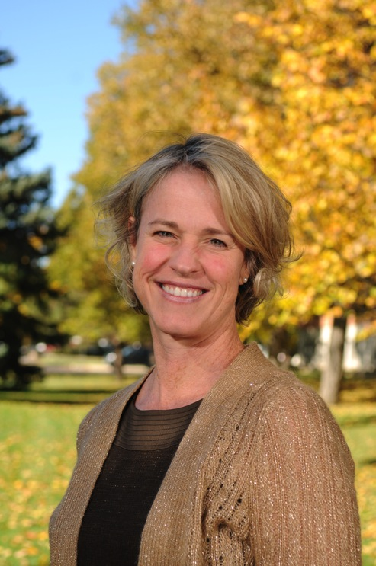
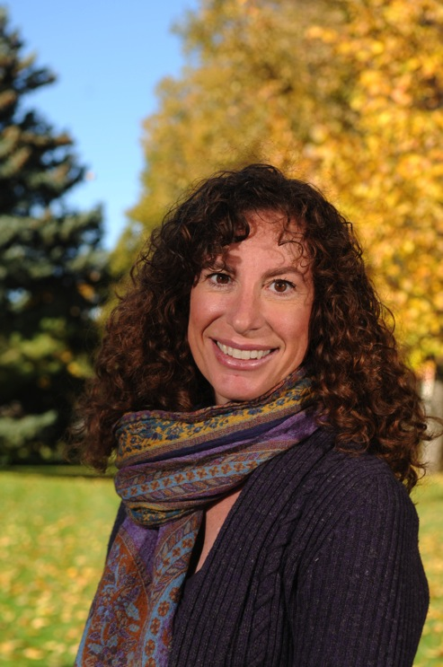
Field Guide to Climate Misconceptions
Susan Buhr
Emily Kellagher

Slide 3
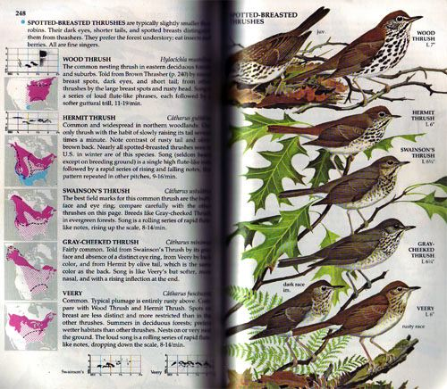
Field Guide to Climate Misconceptions
Strategies to spot misconceptions?
What types of misconceptions exist?
Variations on themes
Addressing misconceptions

Slide 4
What is meant by “misconception”?
mis·con·cep·tion
–noun
: a mistaken idea or view resulting from a misunderstanding of something
Related terms: “naïve idea”, “pre-conception”, “alternate conception”, “weak conception”
Prior conceptions are strongly held
Even correct concepts are likely to be fragmented
Distinction: Cognition vs. misinformation

Slide 5
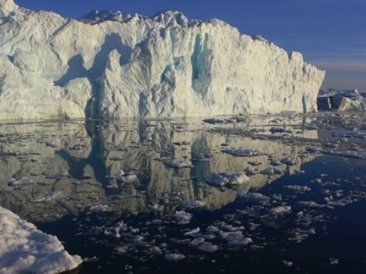
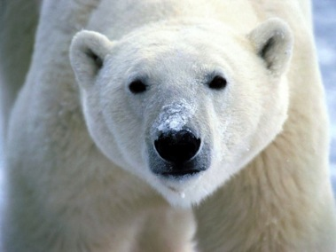
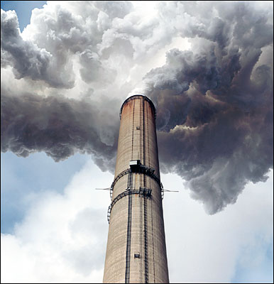
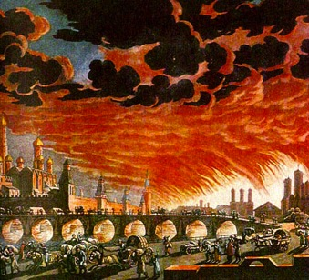
Do misconceptions matter?
happening far away (it’s not urgent)
happening to non-humans (it’s low priority)
it’s pollution (don’t use spray bottles)
it’s weather (can’t affect it)
it’s an apocalypse (it’s too late!)
appropriate mental
models involve a
global systems
perspective
Notes:
We can try to address each climate misconception individually, or we can listen closely to what our audience knows, and try to frame our response in a way that will help them build a more inclusive mental model.
Misconceptions lead to lack of concern, wrong ideas about what can be done.

Slide 6
Try this
Which answer below best represents carbon dioxide levels in the atmosphere today?
450 ppmv
390 ppmv
280 ppmv
180 ppmv
Write on whiteboard or chat: How do you know what you know about your answer? Please be specific.

Slide 7
How do you know what you know?
Group 1
Group 2
Group 3
Group 4

Slide 8
How confident are you?
Which answer below best represents your confidence in your answer?
Very confident
Confident
Somewhat confident
Not at all confident

Slide 9
Carbon Dioxide levels today
Which answer below best represents carbon dioxide levels in the atmosphere today?
450 ppmv
390 ppmv
280 ppmv
180 ppmv
How do you know what you know about your answer? Please be specific.

Slide 10

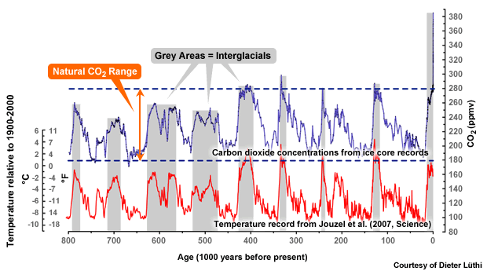
What is today’s CO2 level?
450
Stabilize 2C
Today=393 ppm
390
Pre-Industrial
Last ice age
Graphic from COMET
Graphic: COMET

Slide 11
How do you know what you know?
Experiences
Parents and family
Reading scientific literature
Reading popular literature
Doing professional research
Watching movies/films
Courses, workshops, education
Notes:
This could be made into pictures.

Slide 12

Sources of climate concepts (good, bad and ugly)
“The greatest obstacle to new learning often is not the student’s lack of prior knowledge but, rather, the existence of prior knowledge” Angelo and Cross, Classroom Assessment Techniques, 1993
Everyday experience
Parents, friends
Vicarious experience- movies
Internet-blogs, websites
School, textbook graphics
Help or hindrance?

Slide 13
Spotting misconceptions
What strategies do you use to spot misconceptions?

Slide 14
Novice learner probe
Seven students argued about what they thought were major human causes of global warming. This is what they thought were causes that cold be attributed to humans:
Maria: acid rain
Natalia: burning coal
Tessa: the fuel we use in our cars
Blaine: using leaded gasoline instead of unleaded
Raul: the thinning of the Earth’s ozone layer
Circle the name(s) of the student(s) you agree with. Explain why you agree.
Keeley and Tugel, Uncovering Student Ideas in Science Vol 4, 2009

Slide 15
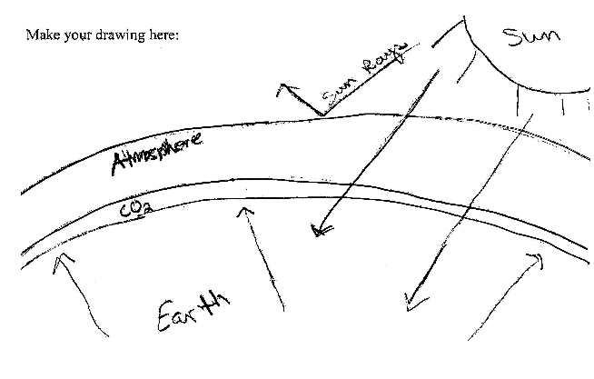
Draw the greenhouse effect2
Shepardson, et. al., 2010

Slide 16
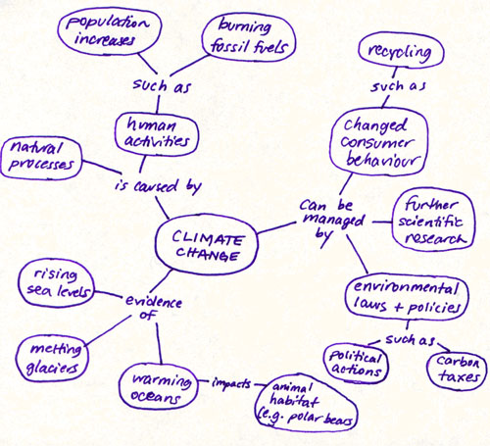
How does climate change impact polar bear habitat?
Example from U. of Victoria
Notes:
What is the probe question?

Slide 17
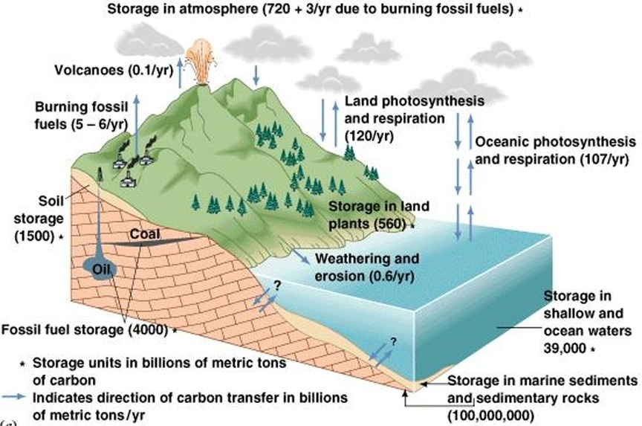
Undergraduate level probe
Q: How might human activities affect the carbon cycle?
Source of Diagram: The Blue Planet, Skinner et al., 1999
courtesy of Dr. John Madsen, U. of Delaware

Slide 18
Uncovering misconceptions
Multiple choice quizzes-caveat
Prior conception probes
Concept maps-shows fragmentation
Class discussion
What else?
Resources:
Angelo and Cross (1993) Classroom Assessment Techniques,
Cutting Edge concept mapping (Gautier, Dempsey)
CLEAN Teaching About pages

Slide 19
Which misconceptions have you spotted?
In breakout room, list all the misconceptions you have encountered related to this assigned area.
Are there any surprises?
How would you start to address these?

Slide 20
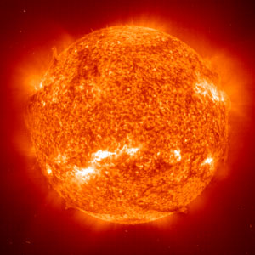
Solar activity
5-6 people per breakout room
10 minutes work time
Write down each misconception
Be prepared to report out
Any surprises?
How to address?

Slide 21
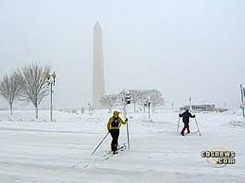
Variability
5-6 people per breakout room
10 minutes work time
Write down each misconception
Be prepared to report out
Any surprises?
How to address?

Slide 22
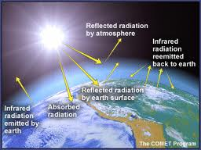
Greenhouse effect
5-6 people per breakout room
10 minutes work time
Write down each misconception
Be prepared to report out
Any surprises?

Slide 23
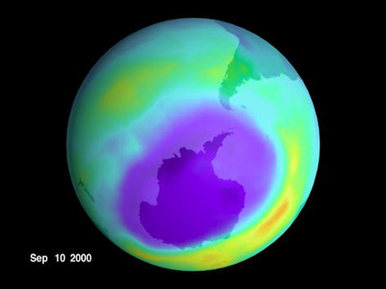
Ozone layer
5-6 people per breakout room
10 minutes work time
Write down each misconception
Be prepared to report out
Any surprises?
How to address?

Slide 24
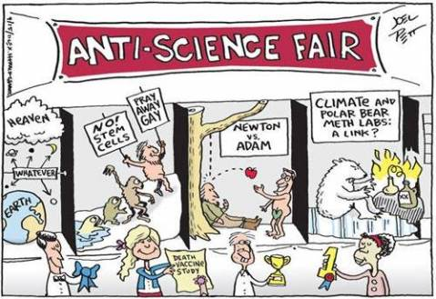
Non/Anti-Science
5-6 people per breakout room
10 minutes work time
Write down each misconception
Be prepared to report out
Any surprises?
How to address?

Slide 25

Report out
2 minutes/group
Notes:
Would someone please share an answer that they picked up
We can identify when we simply heard something and don’t know where we heard it, something based on reading a sound source, something learned through research of credible sources or our own use of data. This is not always so for everyone on every topic though.
Take home message: Upon examination we can judge the soundness of the basis of our concepts (sometimes).

Slide 26
Limits to human agency
Because climate has changed in the past when humans weren’t around, recent climate change is part of a natural cycle
The Earth is too big for humans to change it
The climate system is too complex for humans to understand it (scientific abdication)
Nothing can be done

Slide 27
Stasis-things don’t change
Any changes will be tiny and gradual
Global warming means incremental warming uniformly
Homeostasis confusion-we’ll come back to a steady state.
Also seen in other earth phenomena
Artifact of the term “global warming”

Slide 28
Kinds of misconceptions
Controversy
Cognitive
Overlap

Slide 29
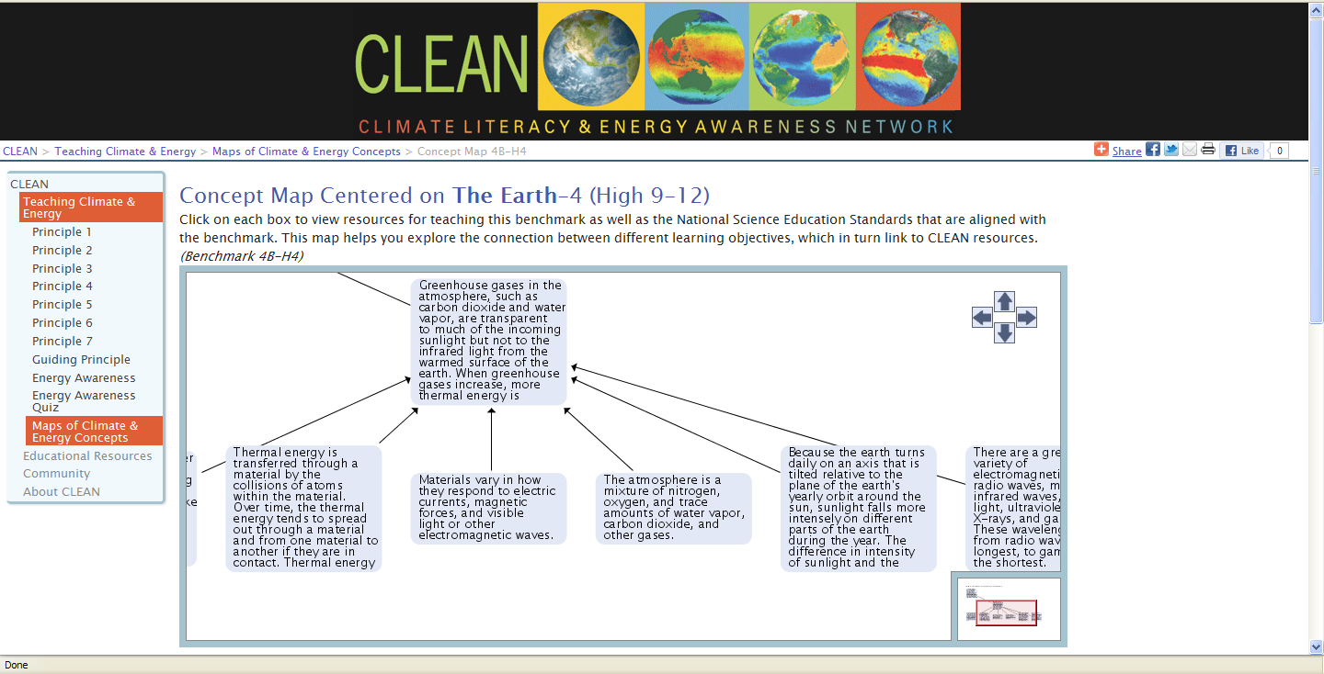
Sources for target concepts

Slide 30
How do you address misconceptions in the classroom?

Slide 31
Strategies that lead to change
Raise student metacognition
Cause cognitive conflict
Understand nature of science, quality of research
Help student “self-repair” misconceptions
Engage students in argumentation to strengthen new knowledge
Joan Lucariello CUNY
Apa.org/education/k12/misconceptions.aspx

Slide 32
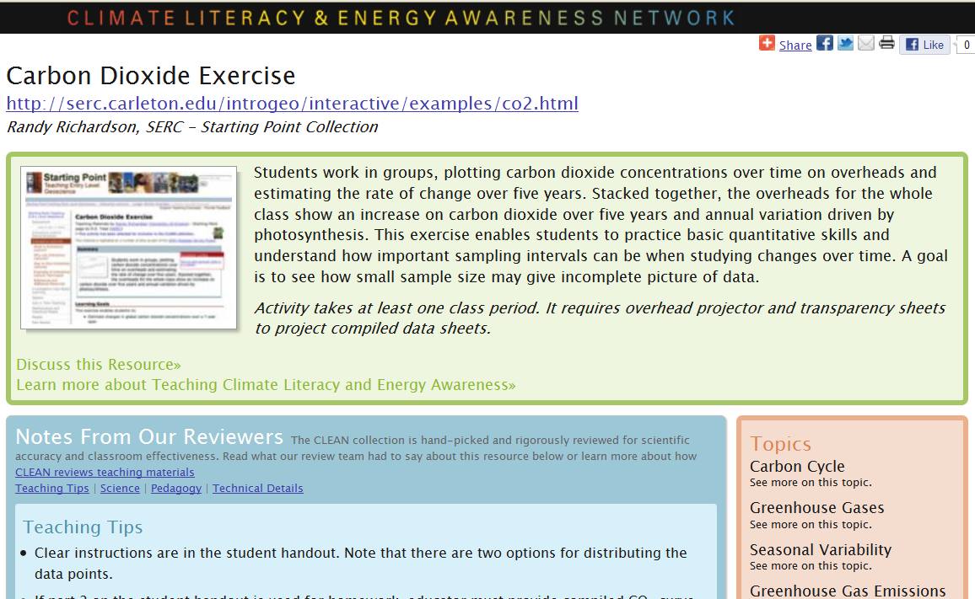
Examples from the CLEAN collection
http://cleanet.org/resources/41805.html

Slide 33
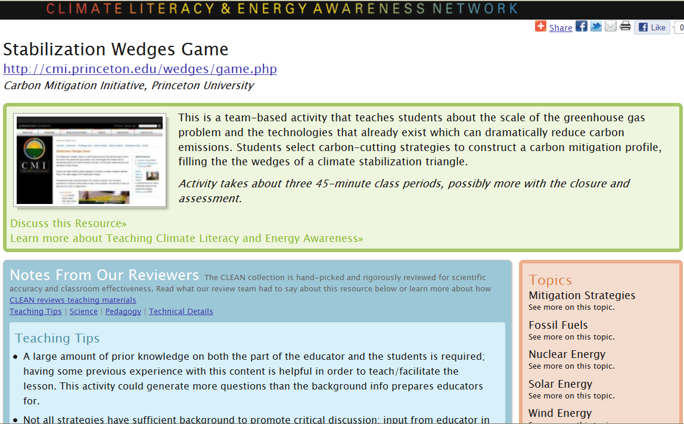
Examples from the CLEAN collection
http://cleanet.org/resources/41709.html

Slide 34
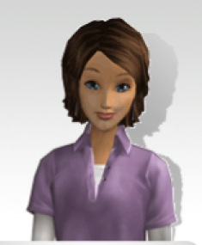

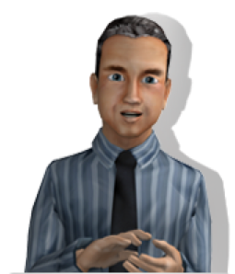
Addressing misconceptions: CO2
Increased CO₂ in the atmosphere is a good thing. Since more CO2 is better for plants won’t it be better for crops?
Doubt it! Do you really think large scale global change will be better for crops?
*Taub, D. (2010) Effects of Rising Atmospheric Concentrations of Carbon Dioxide on Plants. Nature Education Knowledge 1(8):21
…Overall, the carbon, hydrogen and oxygen assimilated into organic molecules by photosynthesis make up ~96% of the total dry mass of a typical plant (Marschner 1995). Photosynthesis is therefore at the heart of the nutritional metabolism of plants, and increasing the availability of CO₂ for photosynthesis can have profound effects on plant growth and many aspects of plant physiology.*
Notes:
What works or doesn’t work about these answers?

Slide 35

Addressing Misconceptions: CO2 debrief
Increased CO₂ in the atmosphere is a good thing. Since plants need CO2 won’t more be better for crops?
Great question. That’s true under controlled lab conditions but under field conditions plants quickly become limited by some other factor, such as water.

Slide 36
Addressing Misconceptions: natural cycle
In my view global warming is just part of a natural cycle. The climate has changed before and it will change again.
The IPCC says today’s climate change is caused by human activities.
Tell me more about how you came to that conclusion....
At one time climate scientists weren’t sure about the causes either…

Slide 37
Addressing Misconceptions: natural cycle debrief
In my view global warming is just part of a natural cycle. The climate has changed before and it will change again.
Your turn

Slide 38
Good practices
Acknowledge the person
Be concise-less is more
Use evidence or reason
Don’t appeal to authority
Don’t use jargon
Do stay personable

Slide 39
Two types of publicly controversial topics
how to apply science
  human reproduction
  embryonic stem cells
  endangered species
  nuclear energy
  responding to climate change
validity of the science
  origin of life
  evolution
  human-caused
  climate change
How should you approach these two types?
For a more detailed description see: http://undsci.berkeley.edu/article/0_0_0/sciencetoolkit_06
Notes:
finer breakdown: http://undsci.berkeley.edu/article/0_0_0/sciencetoolkit_06
Fundamental scientific controversy
Peripheral scientific controversy
Controversy over ethics
Controversy of practical applications
Controversy between science and nonscientific viewpoints
Manufactured controversy

Slide 40
Strategies to forestall controversy
Before instruction:
Get connected to communities
Align with standards and curriculum
Frame for learners’ perspective
Find high quality resources-cleanet.org
(Maybe) talk with administrators

Slide 41
Strategies to forestall controversy
Similar to evolution education
During instruction:
  Controversy as teachable moment
  Integrate climate throughout
  Employ inquiry-based pedagogy
  Outside speakers
  Integrate solutions

Slide 42
Conclusions
As many misconceptions as stars in the sky
But, we may become familiar with major themes
Uncovering misconceptions is easy
“Repairing” takes time and thought
Being a positive, reliable source is important.

Slide 43
Resources
CIRES Education and Outreach: cires.colorado.edu/education/outreach/
Inspiring Climate Education Excellence (ICEE)
  ICEE 101: iceeonline.org
  ICEE online forum: iceeonline.org/forum
Climate Literacy and Energy Awareness Network (CLEAN): cleanet.org
CLEAN webinars and online workshops, ICEE course, ICEE videos
Susan.buhr@colorado.edu
303-492-5657

Slide 45
It’s the Sun, stupid!
Increased radiation causes recent climate change
Increased sun spots cause recent climate change
Changes in Earth’s orbit causes recent climate change
Warming is due directly to sunlight.

Slide 46
carbon concepts study
39% of undergrads held some misconception(s)
misconceptions fell into 4 categories:
  carbon equated with all pollutants
  total carbon is increasing, decreasing, or rate of movement is changing
  carbon thins atmosphere or destroys ozone
  carbon creates a catastrophe

Slide 47
Ozone and climate change
The ozone hole is causing climate change
Global warming is causing the ozone hole
The ozone hole lets in more heat/radiation
Not using aerosol bottles (or polluting) leads to less climate change
Fossil fuel use leads to ozone destruction.
Global warming causes skin cancer
Constructs are fuzzy

Slide 48
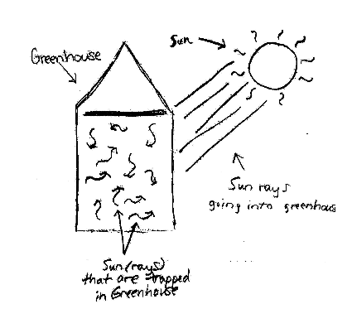
Greenhouse effect: Prior Concepts 1
Like a physical greenhouse
Shepardson, et. al., 2010

Slide 49
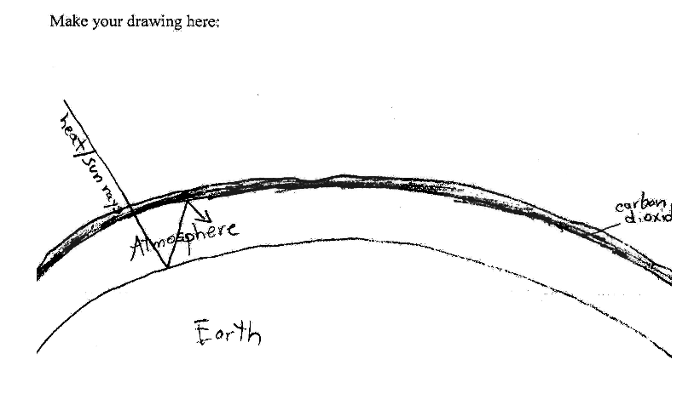
Greenhouse effect: Prior concepts 3
Shepardson, et. al., 2010

Slide 50
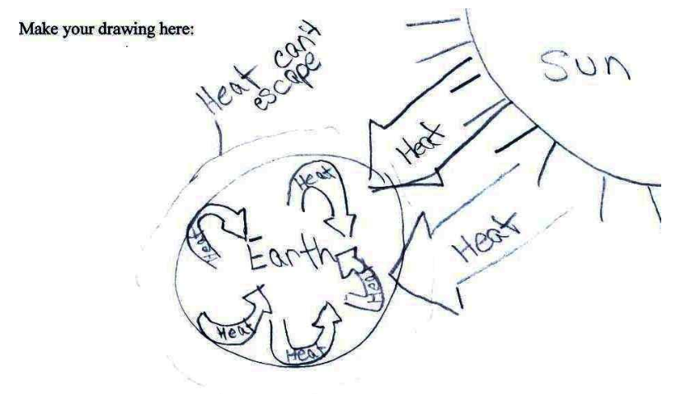
Greenhouse effect: Prior concepts 4
Shepardson, et. al., 2010

Slide 51
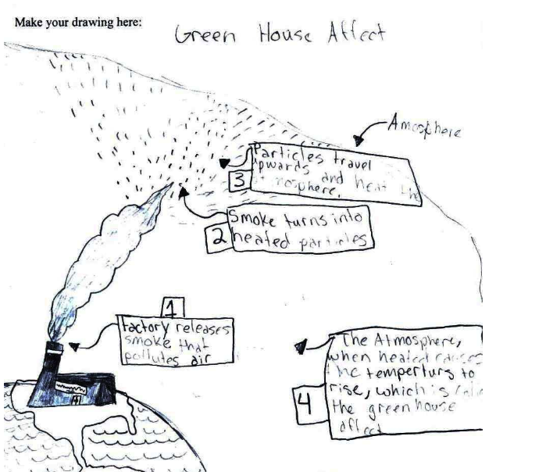
Greenhouse effect: Prior concepts 5

Slide 52

Get Connected
Become a member of the ICEE Forum
www.iceeonline.org/forum
Join the list serve - email
outreach@cires.colorado.edu
Get on the CIRES Education Outreach mailing list – email outreach@cires.colorado.edu

Slide 53
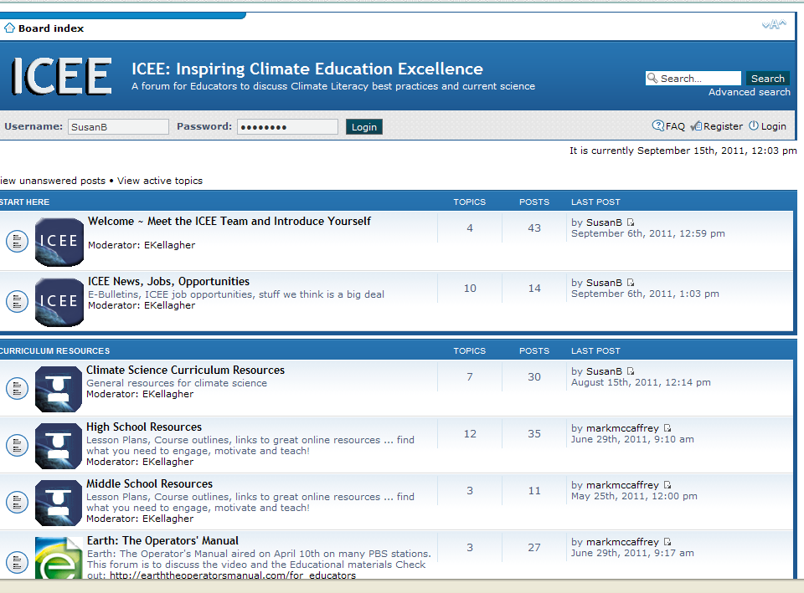

Contact
Susan Buhr susan.buhr@colorado.edu
Iceeonline.org/forum
303-492-5657
Online course Fall 2012
Sign for email list
Questions?

Slide 54
Greenhouse effect
Greenhouse effect is the same as albedo or reflectivity
If other greenhouse gases exist, CO2 is not responsible for recent climate change
Greenhouse effect is same mechanism as a physical greenhouse
Greenhouse effect is bad
Greenhouse effect is due to humans
Greenhouse effect is not proven (less of this one)

Slide 55
Misunderstanding variability
Seasonal: The Equator is warmer because it is closer to the Sun
Seasonal: Summer is warmer because the Earth is closer to the Sun.
Weather is the same as climate-if we have a blizzard, so much for global warming
Sea ice is recovering so climate change isn’t happening

Slide 56
How to Address
It’s not easy.
People are attached to their ideas.
Instruction can improve conceptions
Time, talk, tools

Slide 57
More advanced:
Check all the statements that are True about Greenhouse gases. (GHG)
N₂ is a GHG
Most GHG do not trap heat
Methane is a GHG that does trap heat
Water is a GHG
CO2 lags, not leads temperature rise
Notes:
Sources:
http://ilovecarbondioxide.com/2009/01/top-15-climate-myths.html
http://www.yaleclimatemediaforum.org/2007/10/common-climate-misconceptions-co2-as-a-feedback-and-forcing-in-the-climate-system/

Slide 58
Group Activity
Group 2
Group 1
Group 3
Group 4

Slide 59
What misconceptions are common?
Misconceptions based in everyday experience-sun closer in summer, weather
Talking points in the public media
Less common: Niceties of climate science

