Slide 1
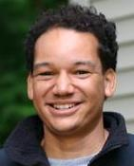
Greenhouse Emissions Reduction
Role-Playing Exercise
Kevin Theissen
Department of Geology
University of St. Thomas, St. Paul, MN
April 5, 2012
To access exercise and teaching notes: http://cleanet.org/resources/42716.html

Slide 2
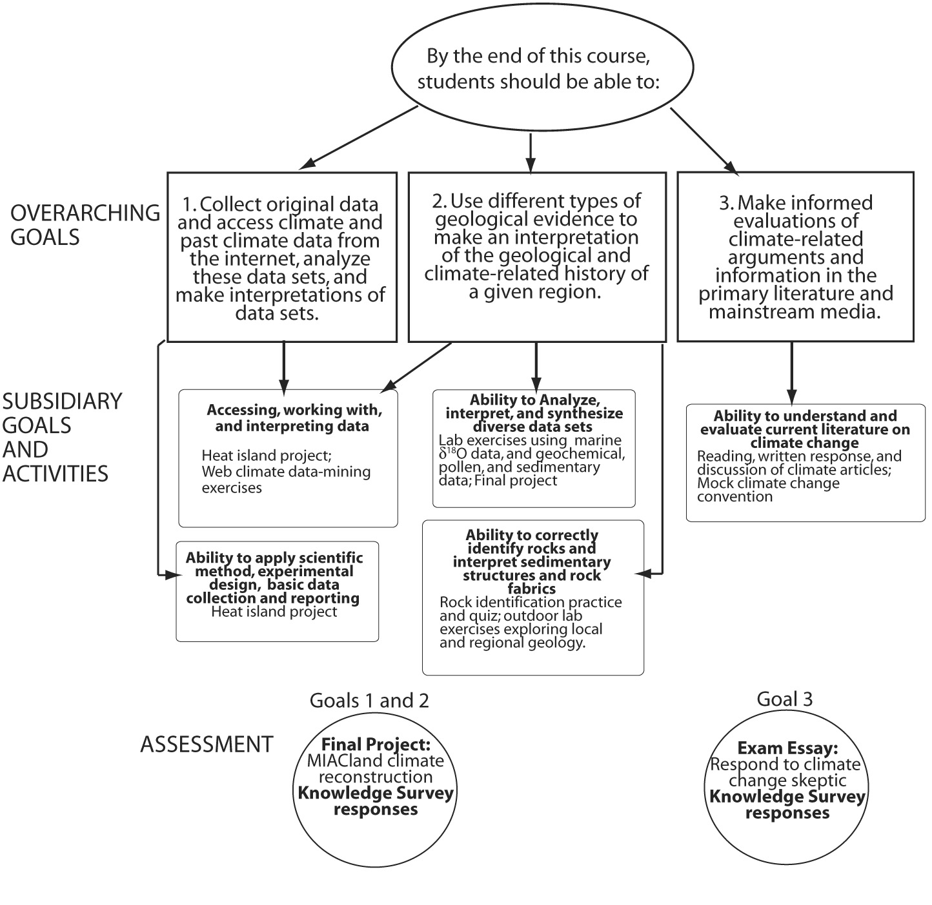
Earth’s Record of Climate course
Theissen, 2008,
J. Geoscience Ed.

Slide 3
The Exercise
Takes the form of a mock “U.S. Convention on Climate Change”
Several delegations (8 in student version) prepare brief statements and presentations, lobby others, deliberate, and ultimately vote on a bill to reduce greenhouse gas emissions.
Assessment:
A written position statement which serves as student “ticket” to the Convention.
Group work during the Convention including quality of presentation, use of data, effort (graded with a rubric).

Slide 4
Why role-playing?
Role playing is a nice way of exploring various problems and their solutions.
Students learn both the complexity of issues as well as the more subtle aspects. (i.e. for students with black-and-white views).
Students develop skills of taking initiative, communication, problem-solving, and working collaboratively. (Harwood et al., 2002, Gautier and Rebich, 2005)

Slide 5

United States Convention on Climate Change
April 5, 2012

Slide 6
Agenda
Each delegation will have the floor for 2 minutes to make statement and field questions.
Vote. Voting options:
Acceptance of bill- reduce by 25% of 2005 emissions levels by 2020
Amendment and reduction at a different level
Rejection
2/3 majority needed for acceptance

Slide 7
The Delegations
Domestic delegations (VOTING):
U.S. Congressional Subcommittee on Climate Change
Maureen Aylward, Charlie Cottingham, Theresa Datuin, Stacy DeVeau, Cathy Techtmann
Organization of Concerned Climate Scientists
Michael Evans, David Feary, Evilina Felicite-Maurice, Gretchen Guzman
Fossil Fuels For a Strong America
Duane Hampton, Elisabeth Harthcock, Julie Lambert, Anna Lewis
Green Business Organization
Jon Leydens, Liliana Marin, Rose Njoroge, Serena Poli
REALGREEN Environmental
Alberto Ramirez, David Randle, Mathieu Richaud, Laura Rico-Beck
Citizen Advocates of America
Juliette Rooney-Varga, Paul Ruscher, Ellie Sommer, Susan Spierre

Slide 8
Maureen Aylward, Charlie Cottingham, Theresa Datuin, Stacy DeVeau,
Cathy Techtmann
The U.S. Congressional subcommittee
On climate Change

Slide 9
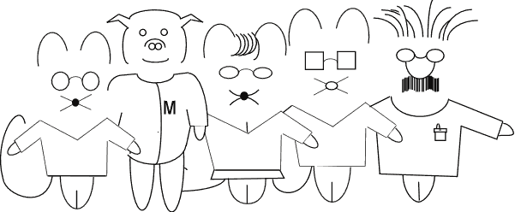
Michael Evans, David Feary,
Evilina Felicite-Maurice, Gretchen Guzman
The Organization of Concerned Climate Scientists

Slide 10
Duane Hampton, Elisabeth Harthcock,
Julie Lambert, Anna Lewis
Fossil Fuels For a Strong America

Slide 11
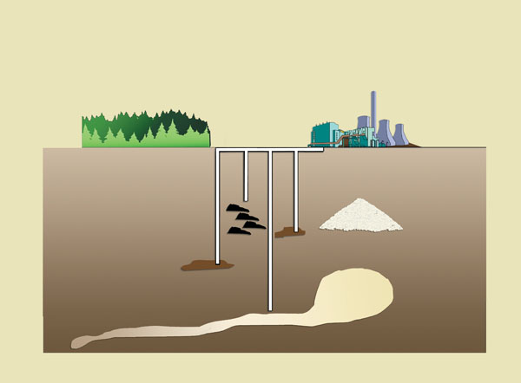
Jon Leydens, Liliana Marin, Rose Njoroge, Serena Poli
The Green businesses’ Organization
CO₂

Slide 12
Alberto Ramirez, David Randle, Mathieu Richaud, Laura Rico-Beck
REALGREEN

Slide 13
Juliette Rooney-Varga, Paul Ruscher, Ellie Sommer, Susan Spierre
The citizen Advocates of America

Slide 14
Coalition of Industrializing Nations

Slide 15
Vote!
Accept the bill; Reduce by 25% of 2005 emissions level by 2020.
Amend the bill; reduce emissions at a different level (to be determined).
Reject the bill

Slide 16
Questions?

Slide 17
A few tips on running the exercise
Challenge students’ black and white thinking: If you know that you have a student who clearly has end-member views place them into a delegation with very different views.
Playing the role: push students to really get into their role. More fun for all.
Lecture or lab?: I prefer prepping for and running the role-play over 2 lab sessions, but it can be tailored to run in lecture.

Slide 18
Feedback from students during wrap-up session
Clear that they prefer role-play to taking their real life positions.
A few students commented that there should be more contrarian positions to make it more realistic.
Many students liked the current format but others expressed interest in the idea of representing a nation in an international meeting rather than an interest group.
Students often mention this exercise on SROTs. Many more positive comments than negative.

