Slide 1



Myth Debunking
John Cook
Climate Literacy and Environmental Awareness Network
^{Date: 4 April 2012}

Slide 2
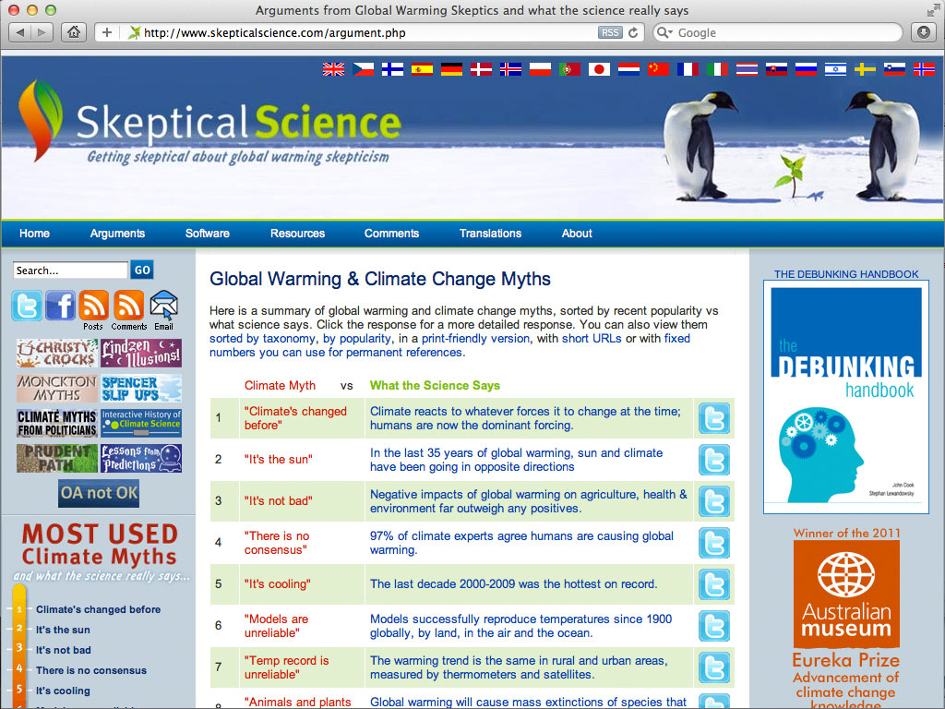

Slide 3
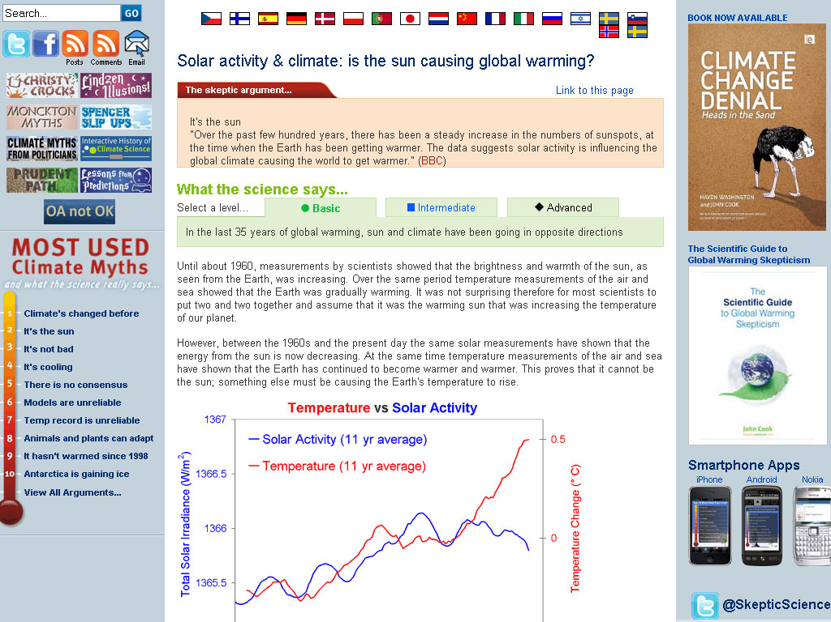

Slide 4
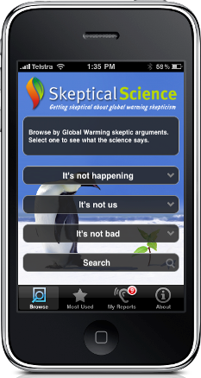

http://sks.to/iphone

Slide 5
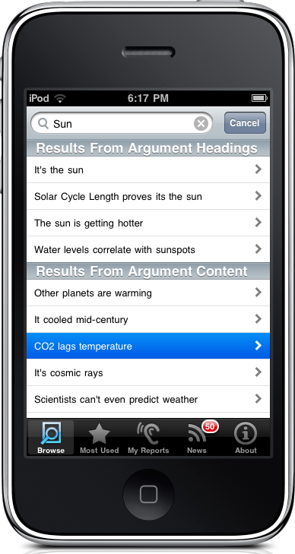
http://sks.to/iphone

Slide 6
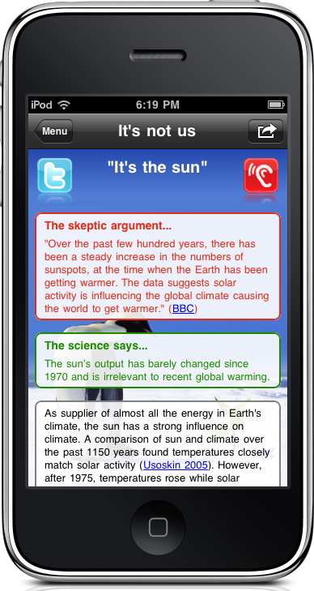
http://sks.to/iphone

Slide 7
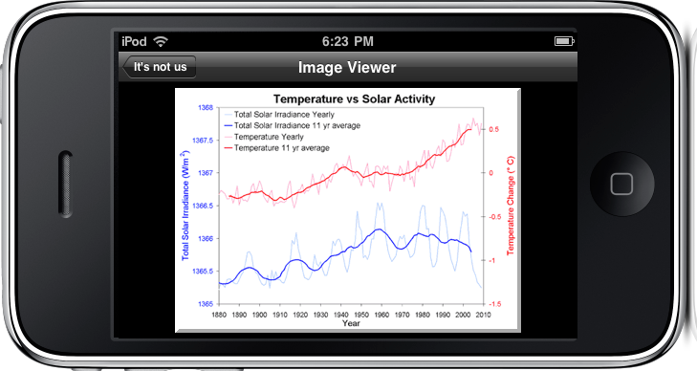
http://sks.to/iphone

Slide 8
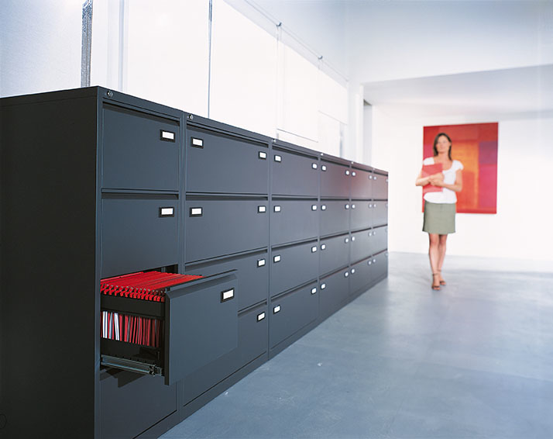
One Model of the Human Brain

Slide 9
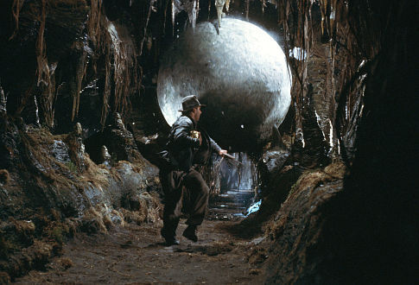
A More Accurate Model
of the Human Brain

Slide 10

Familiarity
Backfire Effect
Debunking a myth can reinforce the myth in people’s minds
(Schwarz et al 2007)

Slide 11
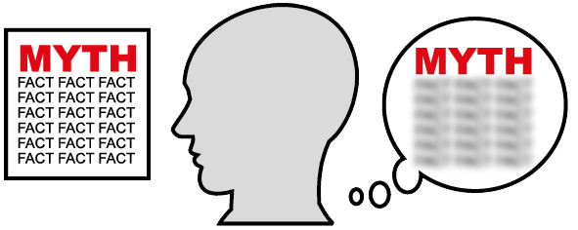
Familiarity Backfire Effect

Slide 12
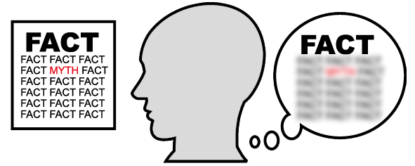
Familiarity Backfire Effect

Slide 13
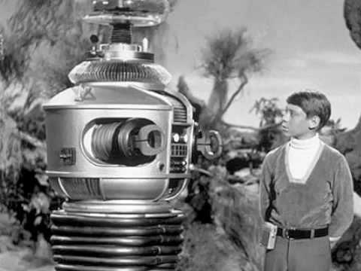
Danger,
Will Robinson!
Approaching
myth!

Slide 14
The Overkill Backfire Effect
A simple myth is more cognitively attractive than an over-complicated correction
(Schwarz et al 2007)

Slide 15
The Overkill Backfire Effect
A simple myth is more cognitively attractive than an over-complicated correction
(Schwarz et al 2007)

Slide 16
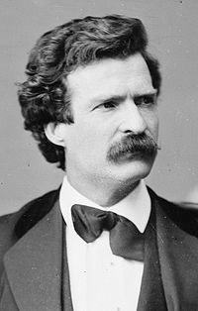
“I didn’t have time
to write a short letter,
so I wrote a long one instead.”
MARK TWAIN

Slide 17
The Worldview Backfire Effect
Issues that tie in with worldviews and sense of identity

Slide 18
The Worldview Backfire Effect
Issues that tie in with worldviews and sense of identity
Republicans who believed Saddam Hussein was linked to 9/11 were shown evidence that there was no link (Prasad et al 2009)

Slide 19
The Worldview Backfire Effect
Issues that tie in with worldviews and sense of identity
Republicans who believed Saddam Hussein was linked to 9/11 were shown evidence that there was no link (Prasad et al 2009)
Only 2% consciously changed their mind

Slide 20
The Worldview Backfire Effect
Issues that tie in with worldviews and sense of identity
Republicans who believed Saddam Hussein was linked to 9/11 were shown evidence that there was no link (Prasad et al 2009)
Only 2% consciously changed their mind
Attitude bolstering: bring supporting facts to mind, ignoring contrary facts

Slide 21
The Worldview Backfire Effect
Strongest among those fixed in their views. Efforts best targeted towards undecided majority

Slide 22
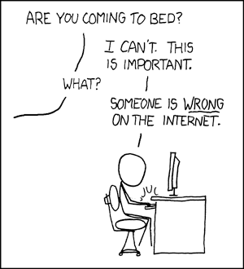

Slide 23
The Worldview Backfire Effect
Strongest among those fixed in their views. Efforts best targeted towards undecided majority
Messages can be framed to affirm worldview. Conservatives accepted climate science with nuclear power
(Kahan et al 2007)

Slide 24
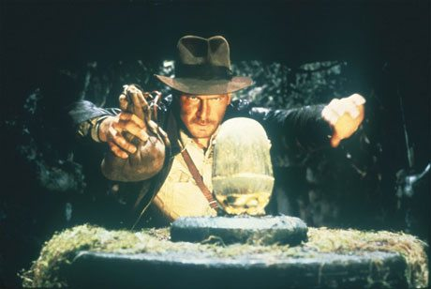
Another psychological pitfall

Slide 25
Create a Gap

Slide 26
Fill the Gap

Slide 27
Elements to an Effective Debunking
Fill the gap with an alternative explanation
Create a gap with the facts

Slide 28
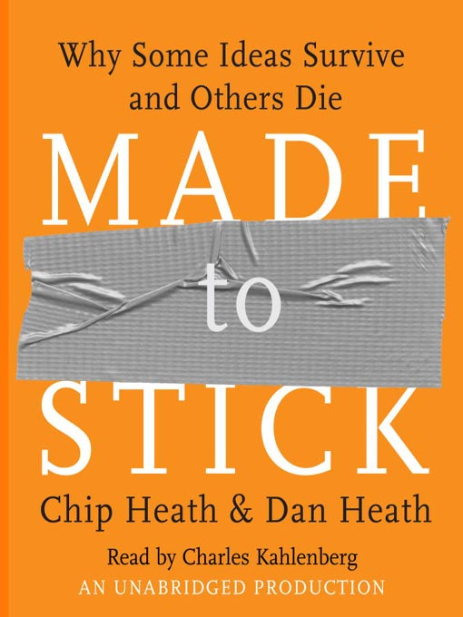

Slide 29
“Fight sticky ideas with stickier ideas.”

Slide 30
The Curiosity Gap

Slide 31
The Curiosity Gap
Generate curiosity by opening gaps in their knowledge then filling those gaps

Slide 32
Debunking Method
Fill the gap with an alternative explanation
Create a gap with the facts

Slide 33
Debunking Method
Fill the gap with an alternative explanation
Create a gap with the facts
Generating Curiosity
Create a gap to generate curiosity
Fill the gap with answers to questions

Slide 34
Case Studies of Debunking in Classroom
“Agnotology as a Teaching Tool: Learning Climate Science by Studying Misinformation”
(Bedford 2010)

Slide 35
Case Studies of debunking in classroom
“Agnotology as a Teaching Tool: Learning Climate Science by Studying Misinformation”
(Bedford 2010)
“The Effect of Refuting Misconceptions in the Introductory Psychology Class”
(Kowalski & Taylor 2009)

Slide 37
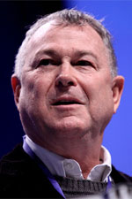
Example of a Debunking
“…the earth quit warming and now we may be in a cooling cycle.”
DANA ROHRABACHER

Slide 38
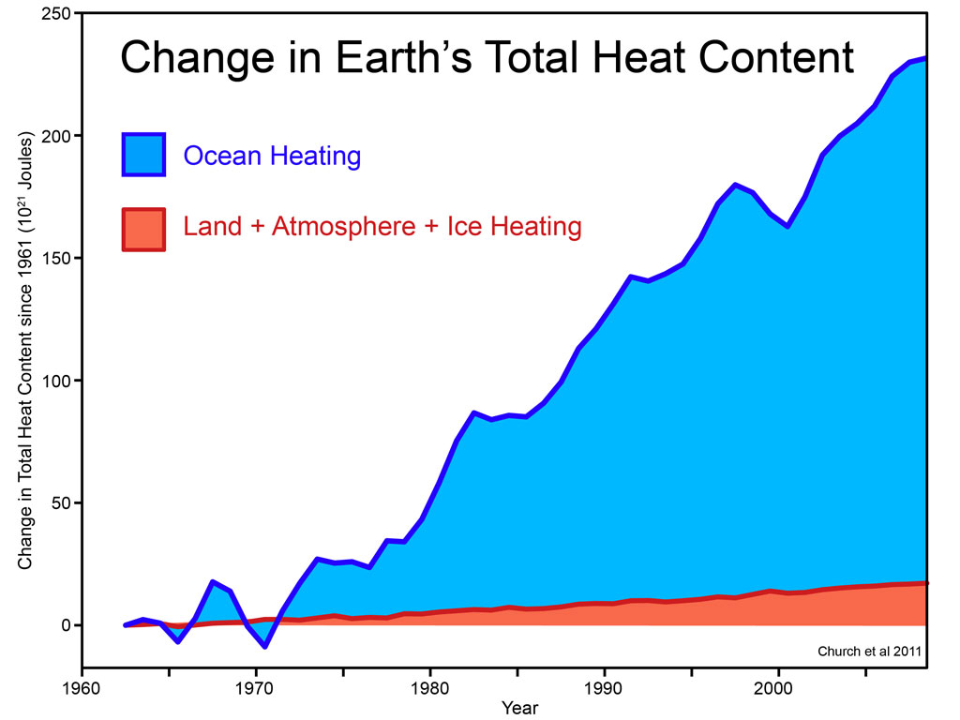
Notes:
38

Slide 39
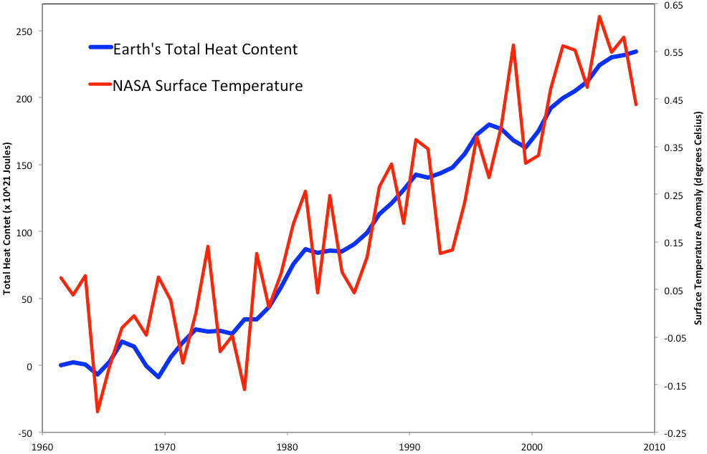
Notes:
39

Slide 40
Core Fact
Explicit Warning
Myth
Alternative
Explanation

Slide 41
Core Fact
Explicit Warning
Our planet is building up heat at a rate of 2 Hiroshima bombs per second.
Myth
Alternative
Explanation

Slide 42
Core Fact
Explicit Warning
Our planet is building up heat at a rate of 2 Hiroshima bombs per second.
The cooling myth focuses on a small piece of the puzzle while ignoring the full picture
Myth
Alternative
Explanation

Slide 43
Core Fact
Explicit Warning
Our planet is building up heat at a rate of 2 Hiroshima bombs per second.
The cooling myth focuses on a small piece of the puzzle while ignoring the full picture
Myth
Alternative
Explanation
Short periods where global temperatures cooled slightly prove global warming has stopped.

Slide 44
Core Fact
Explicit Warning
Our planet is building up heat at a rate of 2 Hiroshima bombs per second.
The cooling myth focuses on a small piece of the puzzle while ignoring the full picture
Myth
Alternative
Explanation
Short periods where global temperatures cooled slightly prove global warming has stopped.
Surface temperature jumps up and down because heat sloshes around between the ocean and atmosphere.
Nevertheless, the planet continues to build up heat.

Slide 45
Core Fact
Explicit Warning
Myth
Alternative
Explanation

Slide 46
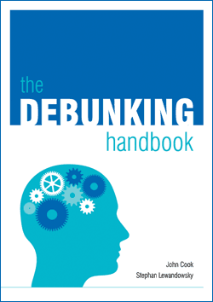
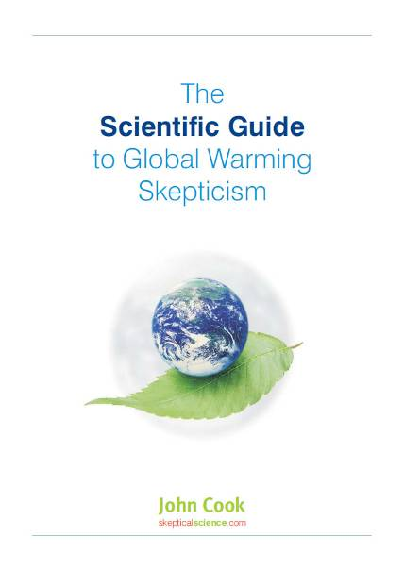
http://sks.to/debunk
http://sks.to/guide

