Slide 1
Sustainability Leadership, C2C
(From Campus to Career)
Eban Goodstein
Director, Bard Center for Environmental Policy &
Director, Bard MBA in Sustainability

Slide 2
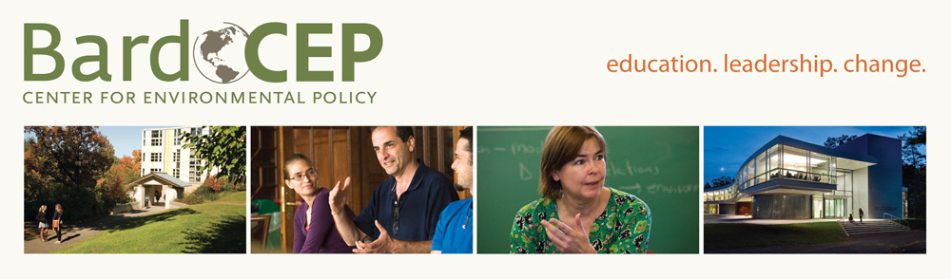
Masters Degrees in Environmental Policy &
Climate Science and Policy
New MBA in Sustainability, in NYC: Fall 2012
Masters International with US Peace Corps
Joint Degree with Pace Law School
3+2 Program: Junior Year at Bard

Slide 3
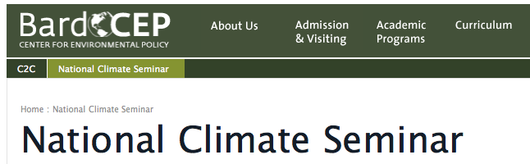
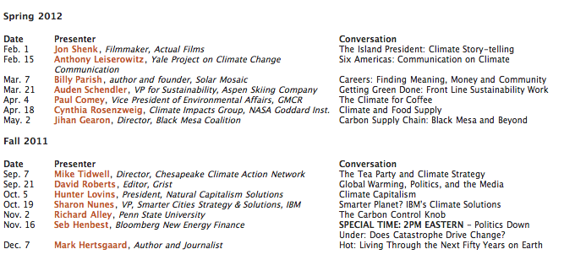
1st & 3rd Weds, Noon Eastern
E-mail climate@bard.edu

Slide 4
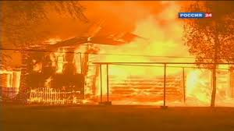
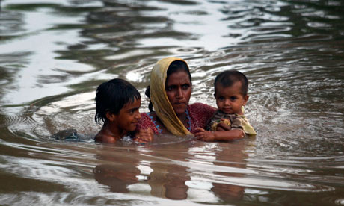
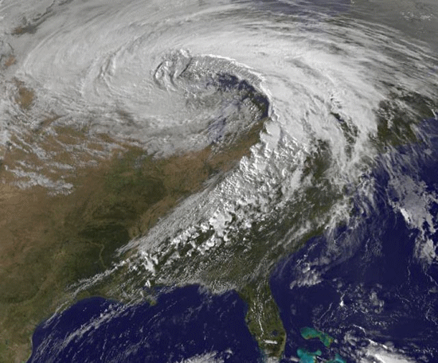
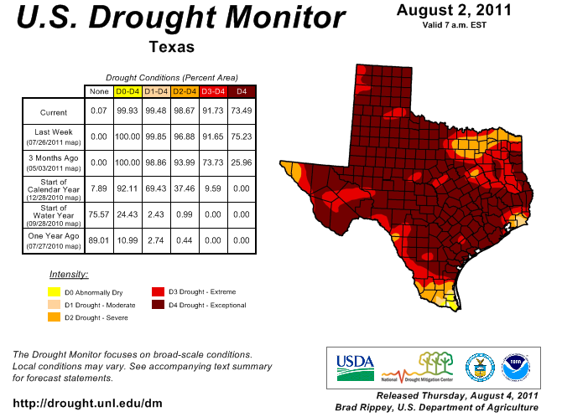
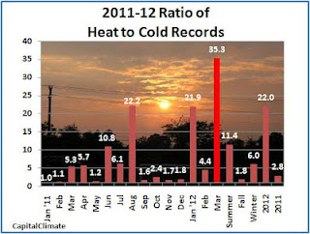
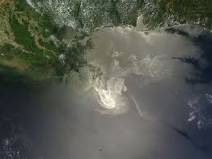
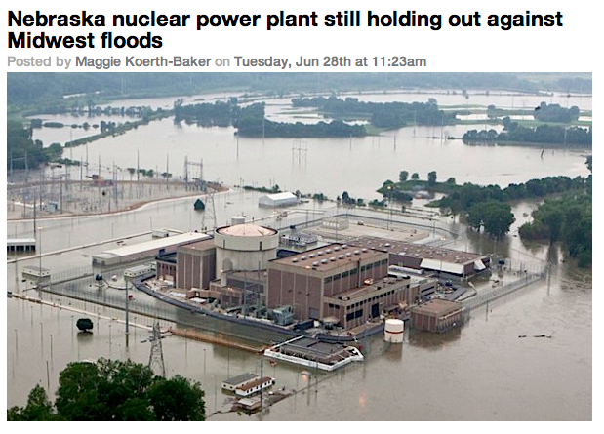
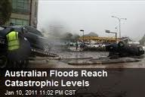

Slide 5
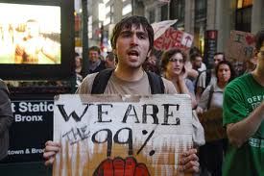

Slide 6
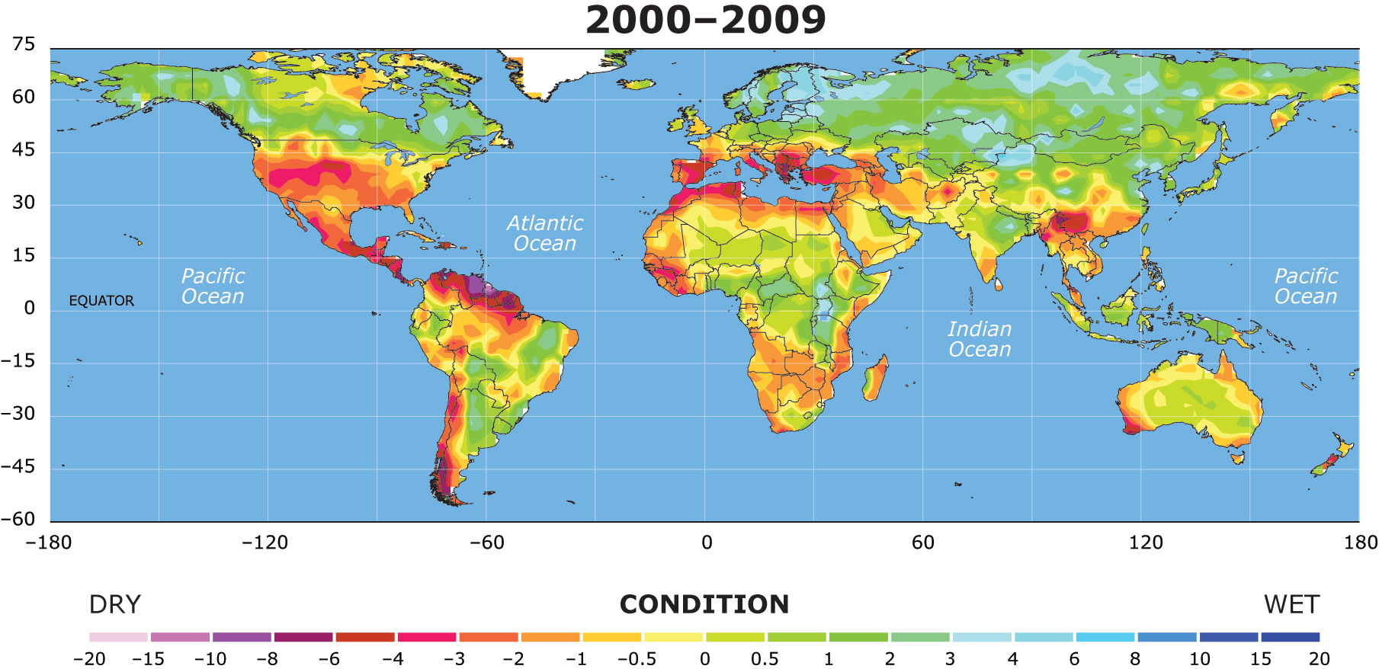
Source: NCAR (2010) [A1B; 700 ppm 2100]

Slide 7
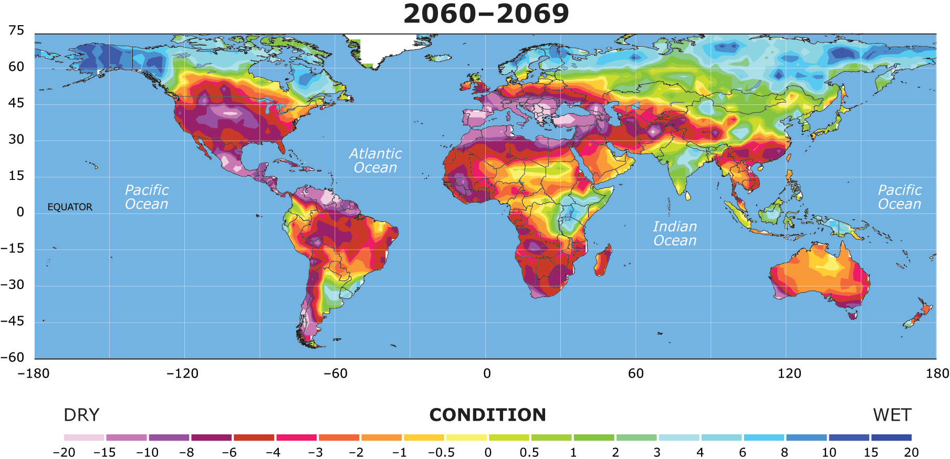
Source: NCAR (2010) [A1B; 700 ppm 2100]

Slide 8
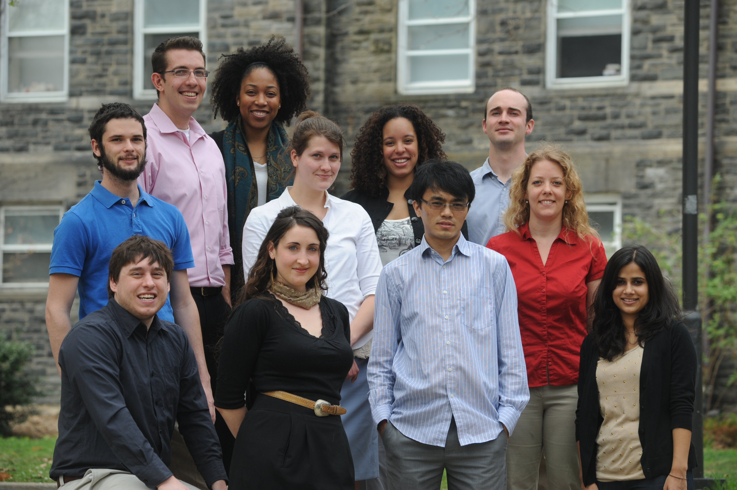
By 2040, The Greatest Generation will transform the global economy

Slide 9
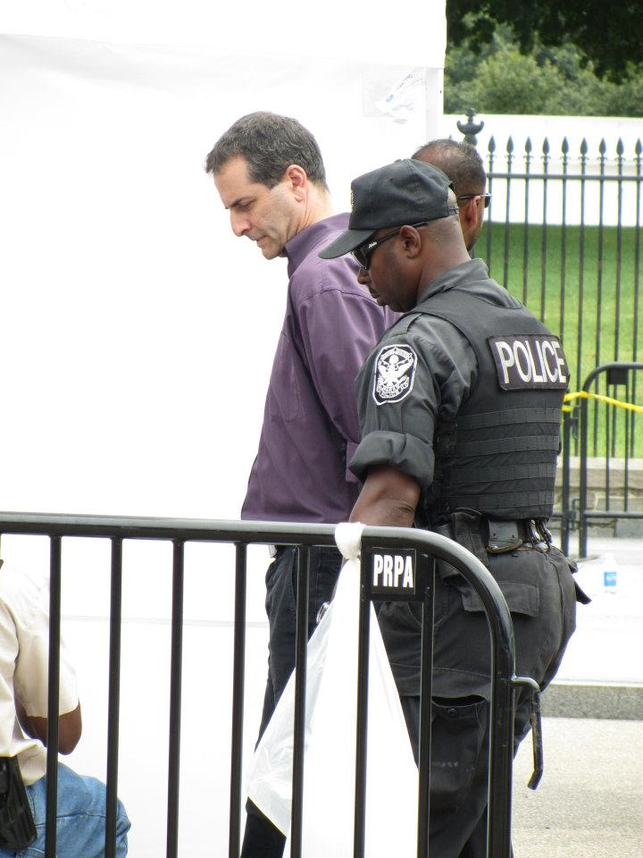
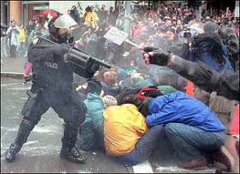

Slide 10
Leadership Careers
How can you
change the future
by the time
you are 30?

Slide 11
By Age 26:
Run for Congress?
Start a green business?
Transform your community?
What would you need to do, learn, experience?
As Educators, how can we close this skills and courage deficit?

Slide 12
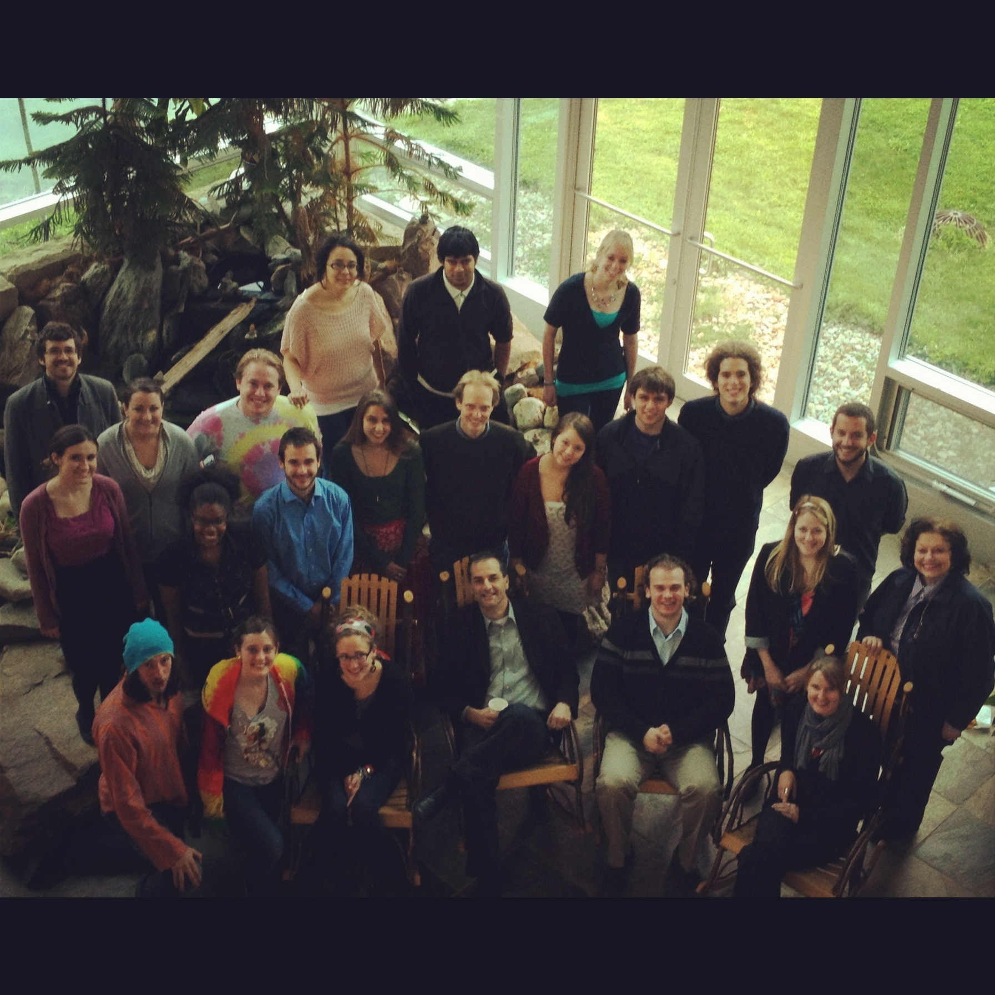
C2C Fellows
www.bard.edu/cep/c2c

Slide 13


Places to Skill Up: $1,000 Scholarships
Politics:
Social Entrepreneurs:
www.bard.edu/cep/c2c

Slide 14
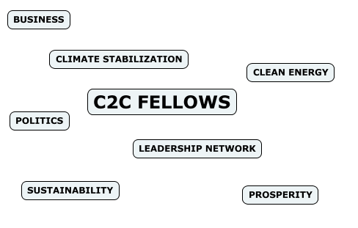
C2C Fellows is the power network for young people with the wisdom, talent, and grace to remake the world.

Slide 15
Graduate Education in Sustainability
(MS in Policy / MBA)
Core Academics
Organizational Experience
Mastery

Slide 16
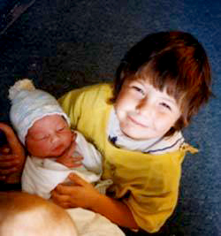

Slide 18
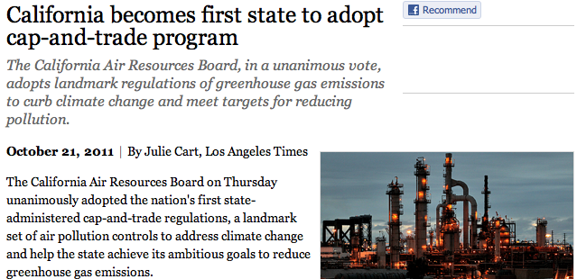

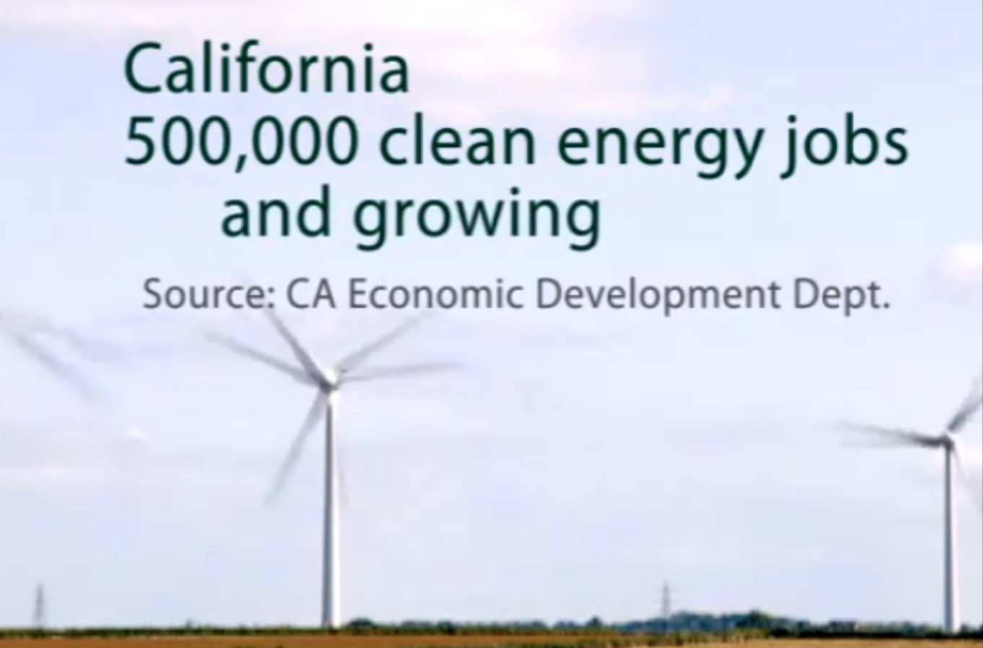
Jobs Versus The Environment Vs Green Jobs

