Slide 1
Agnotology as a teaching tool
Dan Bedford
Geography Department
Weber State University
Ogden UT 84408-1210

Slide 2
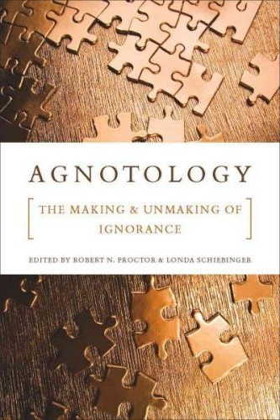

Slide 3
Epistemology:
The study of how and why
we know things

Slide 4
Epistemology:
The study of how and why
we know things
Agnotology:
The study of how and why
we don’t know things

Slide 5
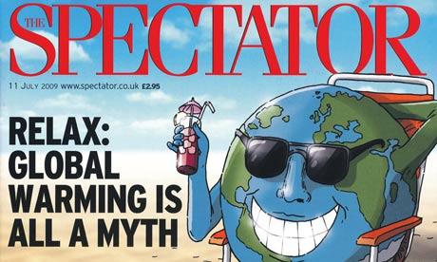

Slide 6
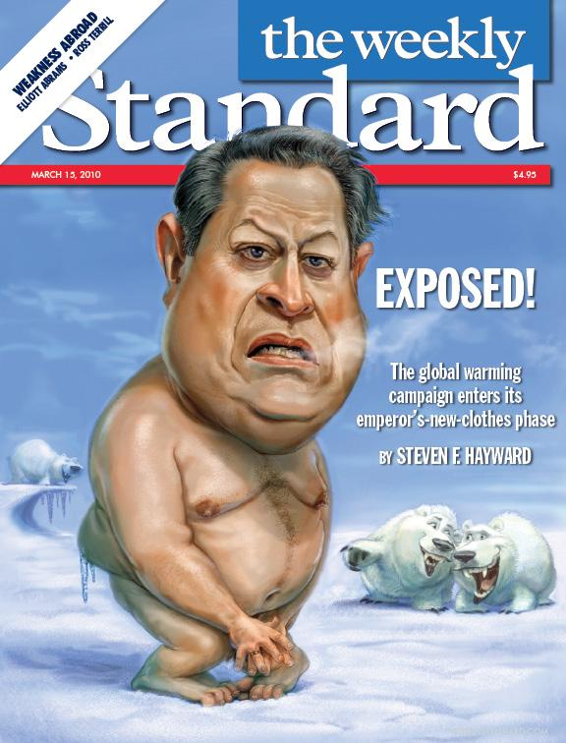

Slide 7
Mallard Filmore cartoon by Bruce Tinsley,
January 15 2011.

Slide 8
QUESTION:
Have you come across materials like these?

Slide 9
QUESTION:
Have your students brought your attention to materials like these?

Slide 10
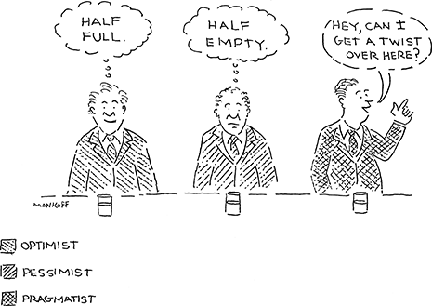
Transition from pessimist to optimist/pragmatist.
Source: The New Yorker March 26 2012.

Slide 11
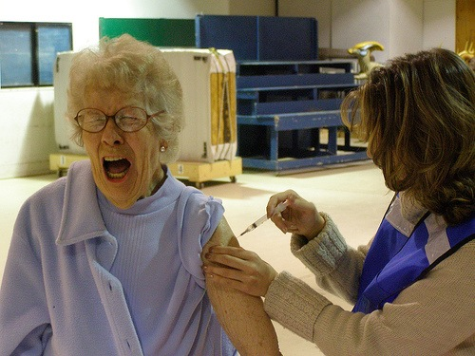
Can I vaccinate my students against misinformation?

Slide 12
The idea
1. Vaccination:
Equip students to identify misinformation
2. Classroom use:
Test student knowledge and critical thinking

Slide 13
The idea (1): vaccination
Identify flaws in specific items of misinformation

Slide 14
The idea (1): vaccination
Identify flaws in specific items of misinformation
Build understanding of general flaws in misinformation

Slide 15
The idea (1): vaccination
Identify flaws in specific items of misinformation
Build understanding of general flaws in misinformation
Neutralize misinformation

Slide 16
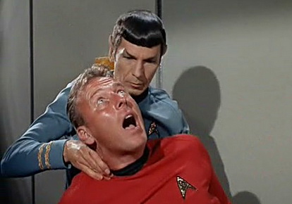
Finding misinformation’s pressure points

Slide 17
The idea (2): classroom use
Use misinformation to test:
  Critical thinking
  Content knowledge
  Persistence/resilience of content knowledge

Slide 18
The idea
Use misinformation to test:
  Critical thinking
  Content knowledge
  Persistence/resilience of content knowledge
These are
LATE-SEMESTER EXERCISES

Slide 19
Case study
Is Global Cooling Next? By Deroy Murdock
Posted 05/05/2008 ET
….NASA satellites found that last winter’s Arctic Sea ice covered 2 million square kilometers (772,000 square miles) more than the last three years’ average. It also was 10 to 20 centimeters (about 4 – 8 inches) thicker than in 2007. The ice between Canada and southwest Greenland also spread dramatically. “We have to go back 15 years to find ice expansion so far south,” Denmark’s Meteorological Institute stated.
“Snows Return to Mount Kilimanjaro,” cheered a January 21 International Herald Tribune headline, as Africa also defies the “warming” narrative.
While neither anecdotes nor one year’s statistics confirm global cooling, a decade of data contradict the “melting planet” rhetoric that heats Capitol Hill and America’s newsrooms.
“The University of Alabama, Huntsville’s analysis of data from satellites launched in 1979 showed a warming trend of 0.14 degrees Centigrade (0.25 Fahrenheit) per decade,” Joseph D’Aleo, the Weather Channel’s first Director of Meteorology, told me. “This warmth peaked in 1998, and the temperature trend the last decade has been flat, even as CO₂ has increased 5.5 percent. Cooling began in 2002. Over the last six years, global temperatures from satellite and land-temperature gauges have cooled (-0.14 F and -0.22 F, respectively). Ocean buoys have echoed that slight cooling since the National Oceanic and Atmospheric Administration deployed them in 2003.”
These researchers are not alone. They are among a rising tide of scientists who question the so-called “global warming” theory. Some further argue that global cooling merits urgent concern.
“In stark contrast to the often repeated assertion that the science of climate change is ‘settled,’ significant new peer-reviewed research has cast even more doubt on the hypothesis of dangerous human-caused global warming,” 100 prestigious geologists, physicists, meteorologists, and other scientists wrote United Nations Secretary General Ban Ki-Moon last December. They also noted that “today’s computer models cannot predict climate. Consistent with this, and despite computer projections of temperature rises, there has been no net global warming since 1998.”

Slide 20
Case study
Is Global Cooling Next? By Deroy Murdock
Posted 05/05/2008 ET
….NASA satellites found that last winter’s Arctic Sea ice covered 2 million square kilometers (772,000 square miles) more than the last three years’ average. It also was 10 to 20 centimeters (about 4 – 8 inches) thicker than in 2007. The ice between Canada and southwest Greenland also spread dramatically. “We have to go back 15 years to find ice expansion so far south,” Denmark’s Meteorological Institute stated.
“Snows Return to Mount Kilimanjaro,” cheered a January 21 International Herald Tribune headline, as Africa also defies the “warming” narrative.
While neither anecdotes nor one year’s statistics confirm global cooling, a decade of data contradict the “melting planet” rhetoric that heats Capitol Hill and America’s newsrooms.
“The University of Alabama, Huntsville’s analysis of data from satellites launched in 1979 showed a warming trend of 0.14 degrees Centigrade (0.25 Fahrenheit) per decade,” Joseph D’Aleo, the Weather Channel’s first Director of Meteorology, told me. “This warmth peaked in 1998, and the temperature trend the last decade has been flat, even as CO₂ has increased 5.5 percent. Cooling began in 2002. Over the last six years, global temperatures from satellite and land-temperature gauges have cooled (-0.14 F and -0.22 F, respectively). Ocean buoys have echoed that slight cooling since the National Oceanic and Atmospheric Administration deployed them in 2003.”
These researchers are not alone. They are among a rising tide of scientists who question the so-called “global warming” theory. Some further argue that global cooling merits urgent concern.
“In stark contrast to the often repeated assertion that the science of climate change is ‘settled,’ significant new peer-reviewed research has cast even more doubt on the hypothesis of dangerous human-caused global warming,” 100 prestigious geologists, physicists, meteorologists, and other scientists wrote United Nations Secretary General Ban Ki-Moon last December. They also noted that “today’s computer models cannot predict climate. Consistent with this, and despite computer projections of temperature rises, there has been no net global warming since 1998.”

Slide 21
Case study
Is Global Cooling Next? By Deroy Murdock
Posted 05/05/2008 ET
….NASA satellites found that last winter’s Arctic Sea ice covered 2 million square kilometers (772,000 square miles) more than the last three years’ average. It also was 10 to 20 centimeters (about 4 – 8 inches) thicker than in 2007. The ice between Canada and southwest Greenland also spread dramatically. “We have to go back 15 years to find ice expansion so far south,” Denmark’s Meteorological Institute stated.

Slide 22
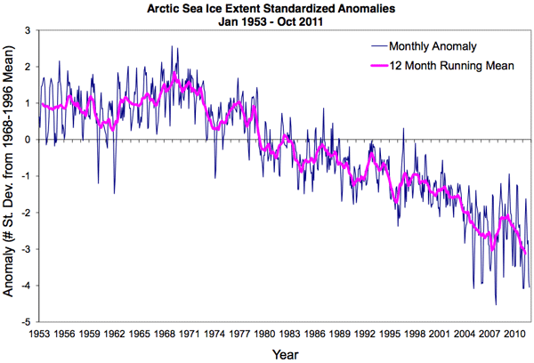
Case study
Is Global Cooling Next? By Deroy Murdock
Posted 05/05/2008 ET
….NASA satellites found that last winter’s Arctic Sea ice covered 2 million square kilometers (772,000 square miles) more than the last three years’ average. It also was 10 to 20 centimeters (about 4 – 8 inches) thicker than in 2007. The ice between Canada and southwest Greenland also spread dramatically. “We have to go back 15 years to find ice expansion so far south,” Denmark’s Meteorological Institute stated.
Source: National Snow and Ice Data Center

Slide 23
Case study
Is Global Cooling Next? By Deroy Murdock
Posted 05/05/2008 ET
….NASA satellites found that last winter’s Arctic Sea ice covered 2 million square kilometers (772,000 square miles) more than the last three years’ average. It also was 10 to 20 centimeters (about 4 – 8 inches) thicker than in 2007. The ice between Canada and southwest Greenland also spread dramatically. “We have to go back 15 years to find ice expansion so far south,” Denmark’s Meteorological Institute stated.
Conflates interannual variability with longer-term trend
Very low sea ice extent makes any increase seem large

Slide 24
Case study
Is Global Cooling Next? By Deroy Murdock
Posted 05/05/2008 ET
“Snows Return to Mount Kilimanjaro,” cheered a January 21 International Herald Tribune headline, as Africa also defies the “warming” narrative.
While neither anecdotes nor one year’s statistics confirm global cooling, a decade of data contradict the “melting planet” rhetoric that heats Capitol Hill and America’s newsrooms.
“The University of Alabama, Huntsville’s analysis of data from satellites launched in 1979 showed a warming trend of 0.14 degrees Centigrade (0.25 Fahrenheit) per decade,” Joseph D’Aleo, the Weather Channel’s first Director of Meteorology, told me. “This warmth peaked in 1998, and the temperature trend the last decade has been flat, even as CO₂ has increased 5.5 percent. Cooling began in 2002. Over the last six years, global temperatures from satellite and land-temperature gauges have cooled (-0.14 F and -0.22 F, respectively). Ocean buoys have echoed that slight cooling since the National Oceanic and Atmospheric Administration deployed them in 2003.”

Slide 25
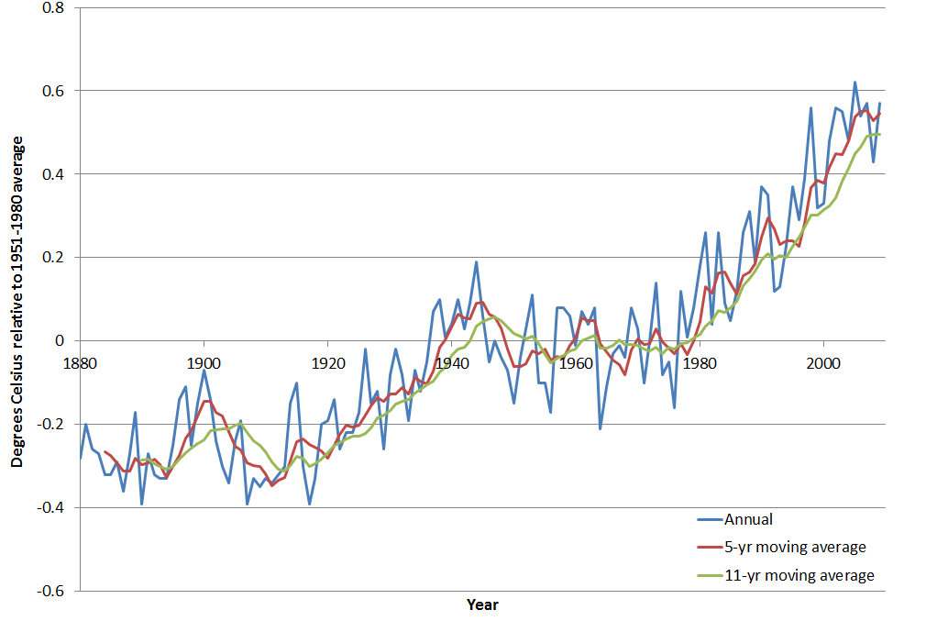
Temperature trend 1880-2009
Source: data from NASA GISS

Slide 26
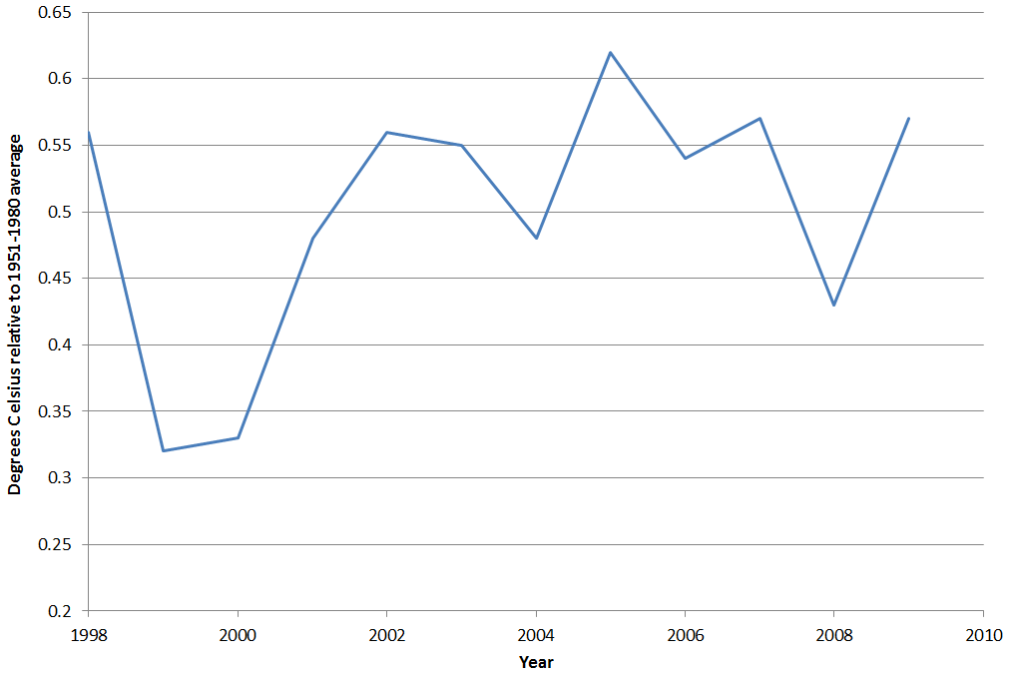
Temperature trend 1880-2009
Source: data from NASA GISS

Slide 27
Case study
Is Global Cooling Next? By Deroy Murdock
Posted 05/05/2008 ET
“Snows Return to Mount Kilimanjaro,” cheered a January 21 International Herald Tribune headline, as Africa also defies the “warming” narrative.
While neither anecdotes nor one year’s statistics confirm global cooling, a decade of data contradict the “melting planet” rhetoric that heats Capitol Hill and America’s newsrooms.
“The University of Alabama, Huntsville’s analysis of data from satellites launched in 1979 showed a warming trend of 0.14 degrees Centigrade (0.25 Fahrenheit) per decade,” Joseph D’Aleo, the Weather Channel’s first Director of Meteorology, told me. “This warmth peaked in 1998, and the temperature trend the last decade has been flat, even as CO₂ has increased 5.5 percent. Cooling began in 2002. Over the last six years, global temperatures from satellite and land-temperature gauges have cooled (-0.14 F and -0.22 F, respectively). Ocean buoys have echoed that slight cooling since the National Oceanic and Atmospheric Administration deployed them in 2003.”
Ten years sounds like a long time, but isn’t in this context
Assumes CO₂ is the only forcing on temperature
Conflates interannual variability with longer-term trend

Slide 28
Case study
Is Global Cooling Next? By Deroy Murdock
Posted 05/05/2008 ET
These researchers are not alone. They are among a rising tide of scientists who question the so-called “global warming” theory. Some further argue that global cooling merits urgent concern.
“In stark contrast to the often repeated assertion that the science of climate change is ‘settled,’ significant new peer-reviewed research has cast even more doubt on the hypothesis of dangerous human-caused global warming,” 100 prestigious geologists, physicists, meteorologists, and other scientists wrote United Nations Secretary General Ban Ki-Moon last December. They also noted that “today’s computer models cannot predict climate. Consistent with this, and despite computer projections of temperature rises, there has been no net global warming since 1998.”

Slide 29
Case study
Is Global Cooling Next? By Deroy Murdock
Posted 05/05/2008 ET
These researchers are not alone. They are among a rising tide of scientists who question the so-called “global warming” theory. Some further argue that global cooling merits urgent concern.
“In stark contrast to the often repeated assertion that the science of climate change is ‘settled,’ significant new peer-reviewed research has cast even more doubt on the hypothesis of dangerous human-caused global warming,” 100 prestigious geologists, physicists, meteorologists, and other scientists wrote United Nations Secretary General Ban Ki-Moon last December. They also noted that “today’s computer models cannot predict climate. Consistent with this, and despite computer projections of temperature rises, there has been no net global warming since 1998.”

Slide 30
Case study
Is Global Cooling Next? By Deroy Murdock
Posted 05/05/2008 ET
These researchers are not alone. They are among a rising tide of scientists who question the so-called “global warming” theory. Some further argue that global cooling merits urgent concern.
“In stark contrast to the often repeated assertion that the science of climate change is ‘settled,’ significant new peer-reviewed research has cast even more doubt on the hypothesis of dangerous human-caused global warming,” 100 prestigious geologists, physicists, meteorologists, and other scientists wrote United Nations Secretary General Ban Ki-Moon last December. They also noted that “today’s computer models cannot predict climate. Consistent with this, and despite computer projections of temperature rises, there has been no net global warming since 1998.”
Show me the publications!

Slide 31
Case study
Is Global Cooling Next? By Deroy Murdock
Posted 05/05/2008 ET
These researchers are not alone. They are among a rising tide of scientists who question the so-called “global warming” theory. Some further argue that global cooling merits urgent concern.
“In stark contrast to the often repeated assertion that the science of climate change is ‘settled,’ significant new peer-reviewed research has cast even more doubt on the hypothesis of dangerous human-caused global warming,” 100 prestigious geologists, physicists, meteorologists, and other scientists wrote United Nations Secretary General Ban Ki-Moon last December. They also noted that “today’s computer models cannot predict climate. Consistent with this, and despite computer projections of temperature rises, there has been no net global warming since 1998.”
Cites scientists’ opinions, not peer-reviewed literature
Conflates interannual variability with longer-term trend

Slide 33
Agnotology in GEOG 3050
(upper division Weather and Climate)
State of Fear: in-class discussion
State of Fear: written homework assignment
Final exam: analysis of syndicated newspaper op-ed

Slide 34
Further exploration
Books and articles
Bedford, D. 2010. | Agnotology as a teaching tool: Learning climate science by studying misinformation. | Journal of Geography 109: 4, 159-165.
Hoggan, J., and R. Littlemore. 2009. | Climate Cover-Up: The Crusade to Deny Global Warming. | Vancouver, Canada: Greystone Books.
Jacques, P. J., R. E. Dunlap, and M. Freeman. 2008. | The organisation of denial: Conservative think tanks and environmental scepticism. | Environmental Politics 17 (3): 349–385.
Manjoo, F. 2008. | True Enough: Learning to Live in a Post-Fact Society. | Hoboken, New Jersey: John Wiley & Sons.
Oreskes, N., and E. Conway. 2010. | Merchants of Doubt: How a Handful of Scientists Obscured the Truth on Issues from Tobacco Smoke to Global Warming. | New York, New York: Bloomsbury Press.
Peterson, T. C., W. M. Connolley, and J. Fleck. 2008. | The myth of the 1970s global cooling scientific consensus. | Bulletin of the American Meteorological Society 89 (9): 1325–1337.
Proctor, R.N., and L. Schiebinger 2008. | Agnotology: The Making and Unmaking of Ignorance. | Stanford, California: Stanford University Press.
Websites
SkepticalScience | http://www.skepticalscience.com/
RealClimate | http://www.realclimate.org
Climate Denial Crock of the Week | http://climatecrocks.com/overview/
Anti-Climate Change Extremism in Utah | http://bbickmore.wordpress.com/

Slide 35
Questions/comments?
Have you tried anything similar?
Potential pitfalls?
What do you like/dislike about this approach?
Other stuff?

