Slide 1
Navigating Climate Change in the Classroom: Teacher preparation, practices and perceptions
Susan Buhr
Director, CIRES Education and Outreach
University of Colorado, Boulder
Notes:
At CIRES Outreach, we have been doing professional development for teachers about climate change since 1996. CIRES is the oldest and largest OAR NOAA joint institute, housed at the University of Colorado, Boulder.
It was clear that teachers and other people who communicate about climate change need to know what the research says about best practices.

Slide 2
Introduction
Teacher Preparation
Knowledge
Influences
Controversy
Professional development
In Community
Strategies
Practices
Standards
Resources
Sustained
Relevant
Notes:
Teacher preparation for, practices in and perceptions of climate change instruction are complex. Many factors go into good instruction including content knowledge, confidence teaching amidst controversy, access to a supportive community and access to high quality resources. There is much to lament but also much to celebrate.

Slide 3
Context of this work
Year | Project | Secondary respondents (N) | Degree of engagement
2009 | ICEE Needs Assessment | 284 | 61%
2010 | CLEAN Invitational Survey | 300 | 56-93%
2011 | CLEAN Informant Network | 145 (97% response rate) | 80% middle school 88% high school

Slide 4
What do you hear from teachers about their preparation?
Their perceptions about climate science?

Slide 5
ICEE, 2009

Slide 6
Perceived relevance of degree

Slide 7


Preparation: Coherent knowledge
More comfort with Earth Systems
Less comfort
  Climate concepts (greenhouse effect)
  Emerging topics (what will happen here?)
  Evidence-how scientists know
“I was confused by the Izzit ‘Unstoppable Solar Cycles’” ICEE 2010, CLEAN 2011

Slide 8
Preparation: Alignment with science
Wise, 2010

Slide 9
“Scientists agree about the causes of recent climate change”
CLEAN, 2011

Slide 10
PD shifts knowledge

Slide 11
“Both sides” Reasoning 2007
Wise, 2010
Notes:
“I feel that teachers should be prepared to discuss counterarguments, but most data seems to point toward human involvement, so that should be presented first
and foremost.” Leadville, CO

Slide 12
Climate science not accepted
2009-2011
“…global climate change is both premature and over-hyped, too much media, too little long term science investigation other than recent trends…”
“I was taught…in late 1960 that we were in fact entering into another “ice age” and today… I am to teach the other end of that continuum?”
“Right now I am very concerned over the global warming emails and the implication that data has been changed…How can I teach about global change if scientists are not being honest about their results?”

Slide 13
Reasoning unclear
2009-2011
“Teaching both perspectives of the issue within time constraints.”
“More support materials-from both sides of the argument are needed-in order to give this topic the time and depth needed to really inform and educate students.”
Denialist? Needs PD? Unclear…..

Slide 14
Climate science accepted
2009-2011
“I am much more confident in my knowledge and the ability to answer student questions, as well as be able to direct students to valid data sites for them to learn to read and interpret the scientific data for their own evidence.”
“I am learning to rely on the science (evidence) and let the facts speak for themselves.” This makes it easier to present to students…and to other teachers.”
“I want to objectively present the scientific data that presents climate change is real and an issue of immediate concern.”

Slide 15
What do you hear from teachers about their barriers and concerns?

Slide 16
Top Instructional Barriers
Lack of alignment with standards
Lack of content knowledge
Parent, student beliefs
Wise, 2010
ICEE, 2009
CLEAN, 2011
Vocal school board members have approached administration, claiming that it is not occurring
Students have been told that “global warming” is not real and that hurdle is hard to cross sometimes.
It conflicts with my students’ religion/faith.
We have some parents that do not believe in climate change/warming
ICEE, 2009

Slide 17
Strategies to forestall controversy
Before instruction:
Align with standards and curriculum
Frame for learners’ perspective
Find high quality resources-evidence/inquiry
(Maybe) talk with administrators

Slide 18
Strategies to forestall controversy
During instruction:
  Employ inquiry, evidence-based pedagogy
  Controversy as a teachable moment
  Integrate climate throughout
  Outside speakers
  Integrate solutions

Slide 19
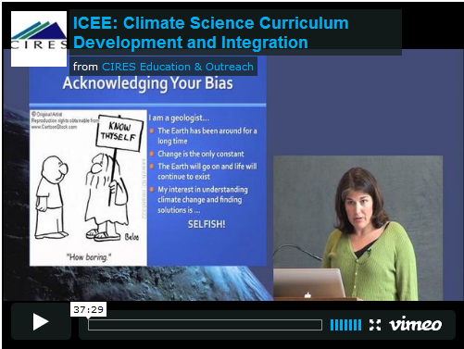

ICEE Teaching Videos
Cheryl Manning, Colorado High School Teacher

Slide 20
Practice: where climate topics are taught
CLEAN 2011

Slide 21
Practice: Time by topic
Wise, 2010

Slide 22
Practice: Instructional time for climate

Slide 23
Teaching practice vs. student interest
CLEAN 2011

Slide 24
Practices: Integration cross-topic
“By connecting this within the physical science curriculum I have been able to bring it in without really labeling it “climate science” which has helped me to keep some of the pre-conceived notions out of the equation.”

Slide 25
Extent to which solutions are considered

Slide 26
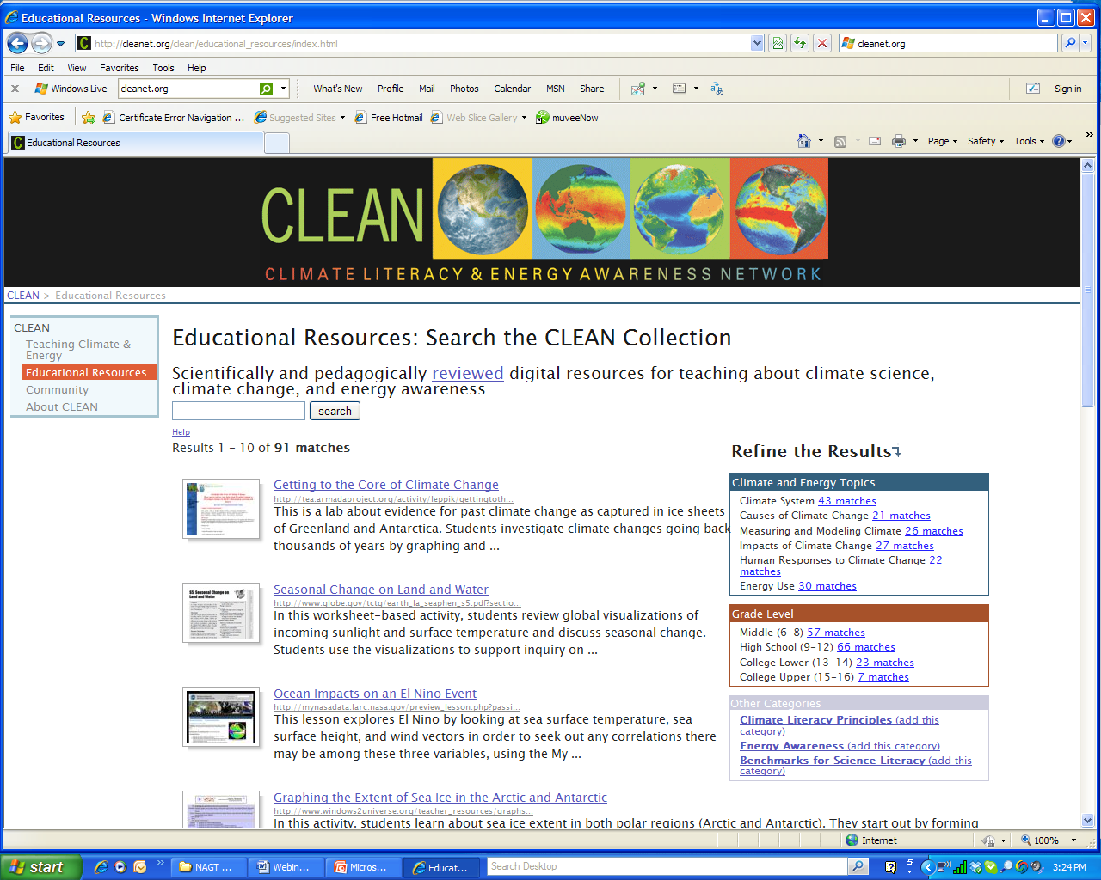
Reviewed climate and energy resources
http://cleanet.org/

Slide 27
Need better materials

Slide 28
Valuable PD: Importance of community
Wise, 2010

Slide 29
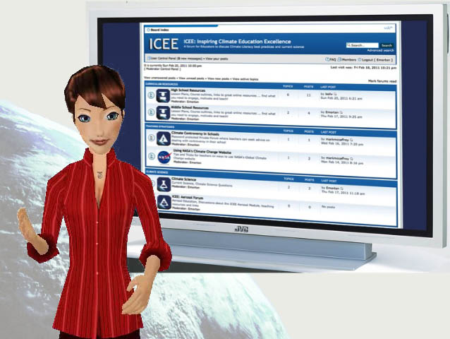
Participation in PD/community
Most perceive institutional support
Most perceived as resource by colleagues
Climate scientist connections
National science/ education communities
Local/regional communities
Iceeonline.org/forum and listserve

Slide 30
Valuable PD: Sustained
CLEAN 2011

Slide 31
Professional development opportunities
Online course ICEE Spring 2012
  3 credit grad ENVS or Continuing Ed or nominal admin fee
  Teaching strategies, Essential Principles Climate Lit, capstone local teaching activity
  Email susan.buhr@colorado.edu
CLEAN webinars
  http://www.cleanet.org/clean/community/webinars/index.html
CLEAN online faculty workshops
  April 2-14, 2012 - Communicating Climate Science in the Classroom
  May 7-16, 2012 - Teaching Climate Complexity

Slide 32
Conclusion
Opportunities:
Reach to all society
High interest
Encouragement is effective
Potential standards alignment
Challenges:
Persistent controversy
Lack of alignmnent with standards
New topic for most

Slide 33
Spacer between presentation and other slides

Slide 34
Question: If you have tried or considered teaching climate change in your classroom, what kinds of challenges have you come up against?
Content (Personal knowledge, Curriculum Integration)
Lack of Resources
Controversy of Topic
Influence of Parents
Lack of Teaching Time
Fatalistic feeling by students
Learnmoreaboutclimate survey among Colorado teachers 2011, N=53

Slide 35
Challenges: Earth Science in H. S.
AGI, Geosci Workforce Report, 2011
See also NAGT Position Paper

