Slide 1
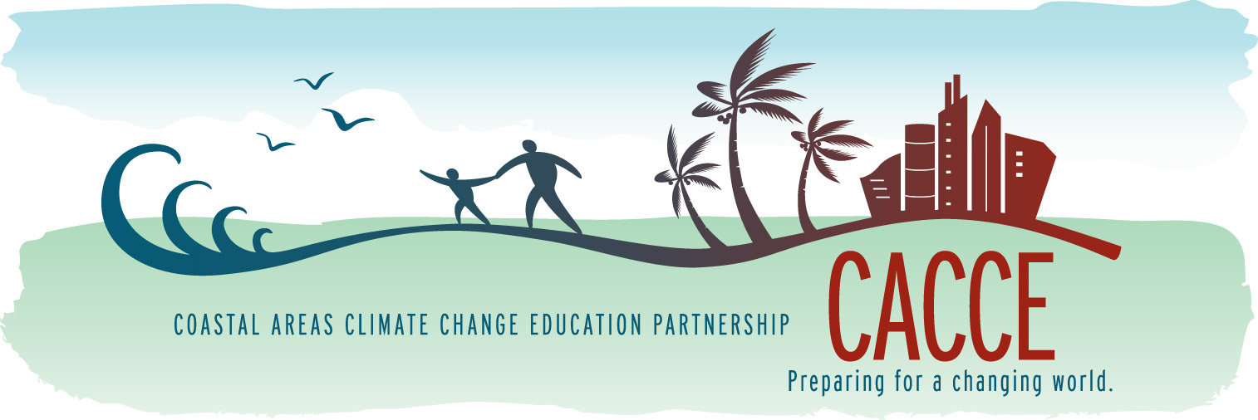
The Coastal Areas Climate Change Education (CACCE) Partnership: Development and Planning Efforts for Climate Change Education in Florida and the Caribbean

Slide 2
What is CACCE?
Coastal Areas Climate Change Education Partnership (CACCE) “catchy”
  Two-year project funded by the National Science Foundation (One of 15 Phase 1 CCEP)
  NSF CCEP Goals:
    Pursue innovative approaches to teaching and learning about climate change;
    Develop new strategies to increase adoption of effective educational resources and practices across a range of stakeholders.
  Deliverables:
    An expanded Partnership
    An implementable Stategic Climate Education Plan

Slide 3







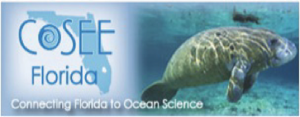








Who is CACCE?
Funded Phase 1 Partners
Strategic Cooperating Partners include:
Photo © 2010 F Muller-Karger

Slide 4
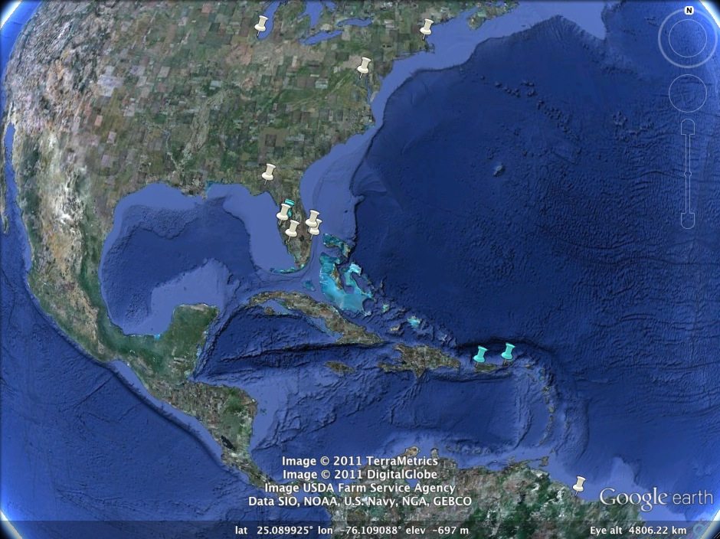
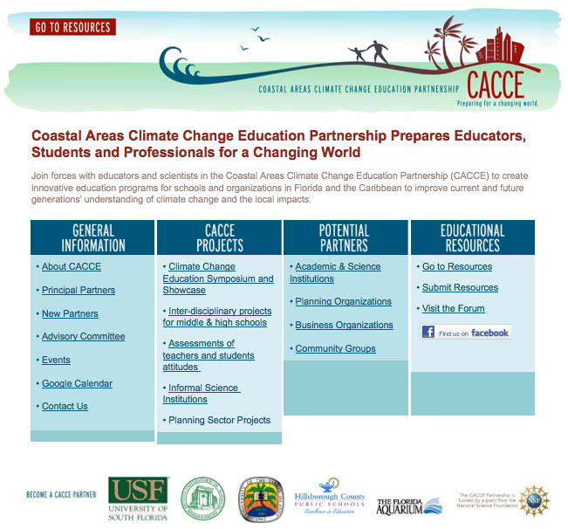
www.cacce.net
Facebook ID:
CACCEpartnership
Blue Pin: Funded Partner
White Pin: Strategic Partner

Slide 5
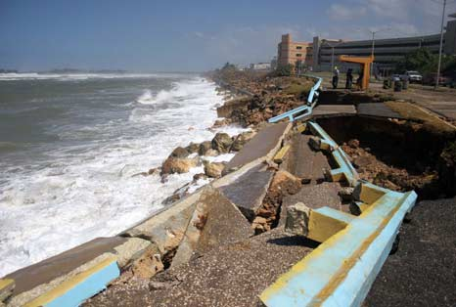
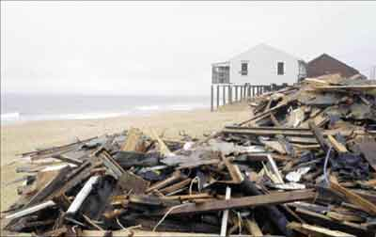
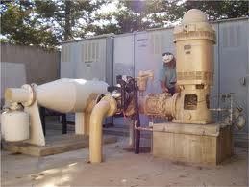
Why CACCE?
A de facto admission: the “usual messages” are not working. New ideas/strategies required for effective public communication/education on climate change.
CACCE’s content emphasis: Near-term, regional impacts of a changing climate:
  Sea level rise
  Storm events and impacts
  Coastal erosion/damage – beach loss
  Water resource problems (availability, quality)
+ Social and economic resiliency strategies
  Adaptation
  Mitigation
  Planning

Slide 6
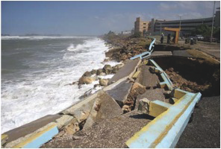
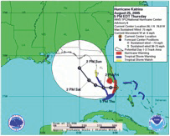
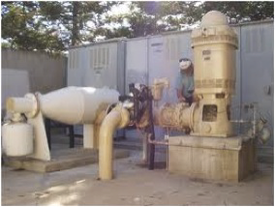
The CACCE “Message”
For Florida and the Caribbean, the impacts of climate change are a problem of the here-and-now. We are focusing on the near-term climate impacts in the low-lying coastal areas of Florida and the Caribbean, emphasizing issues (and stakeholder audiences) impacting the “built environment”.
Audiences:
  K-12 Educators
  Informal Science Educators
  “Built Environment” professionals:
    Urban and Regional Planners
    Policy Professionals (incl. local elected officials…)
    Tourism Industry professionals
    Engineers, Architects

Slide 7
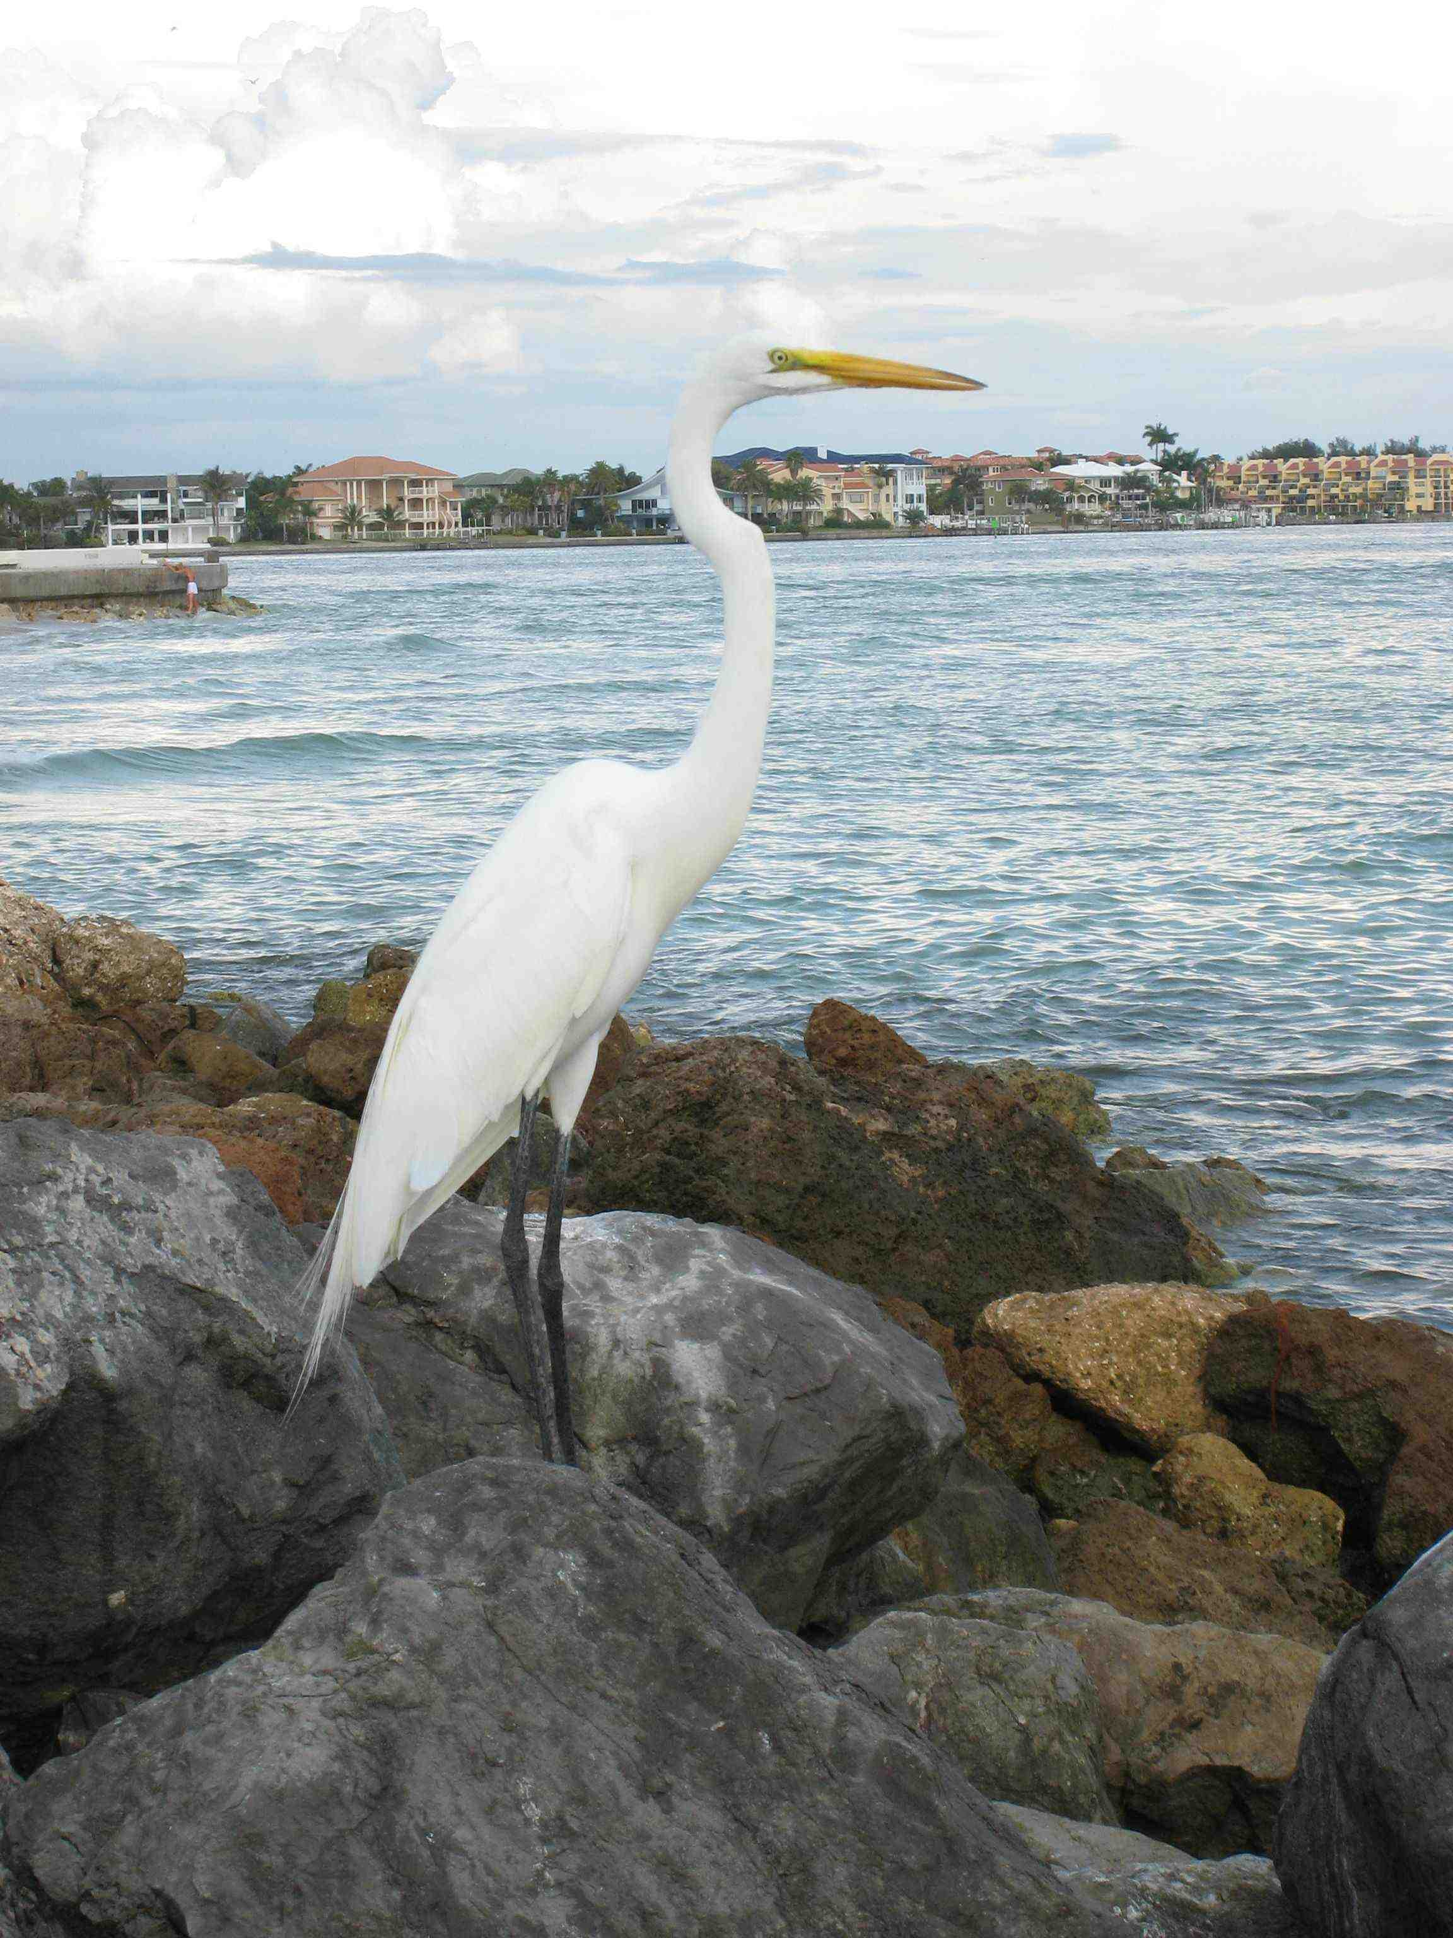
CACCE Phase I Goals
1) Assay existing climate change education resources related to FL/Caribbean/coastal regions
2) Engage key players and stakeholder groups to assess constituent perceptions, and information and education needs
3) Test new models for formal and informal climate education
4) Identify areas for further research on climate change education.
5) Develop a climate change education plan based on stakeholder needs and best practices in education and outreach.
Photo © 2010 F Muller-Karger

Slide 8
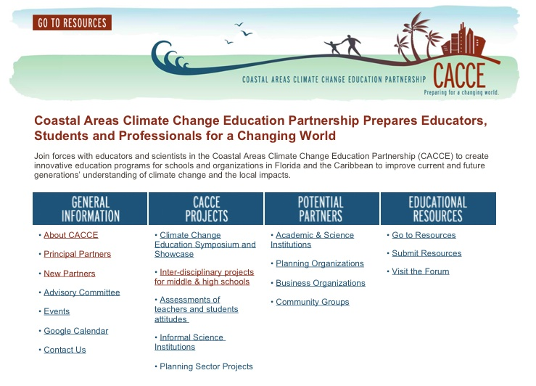
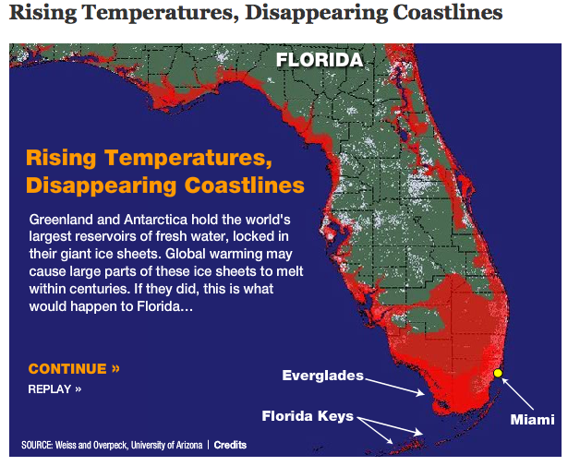
1) Assay existing climate change education resources related to FL/Caribbean/coastal regions
Results: Surprisingly little is available in terms of learning materials, especially in Spanish! But there is a lot of good and accessible information…

Slide 9
2) Engaging key stakeholder groups to assess perceptions, and information and education needs: K-12 education
Surveys of teachers in FL (n=145) and PR (n=479)
Florida and Puerto Rico secondary science teachers hold naive views about CC and CC science.
  46 % FL teachers and 63 % PR teachers responded that the depletion of the ozone layer is a primary cause of CC.
  51% FL teachers and 72% PR teachers agreed that CC science needs to be based on controlled experiments in order to be valid.
Teachers’ climate change instructional practices are largely inadequate.
    52% FL teachers and 33% PR teachers indicated they only mentioned climate change briefly in their classrooms.
  Great divergence in “time on task” for climate change:
    PR ≈ 2 weeks/yr;
    FL ≈2-3 days/yr (!)
Student surveys (1579 in FL and PR): ongoing

Slide 10
Formal Education Activities and Outreach
Curriculum Planning Workshop for Hillsborough County Marine Science teachers, July 2011 (a “CACCE day” on building climate change into the curriculum – a pilot curricular intervention)
CACCE Showcase and Symposium for Hillsborough County School System Educators, Nov 2011
Puerto Rico workshops and conferences for CC scientists and educators in the Caribbean: Feb and Oct 2011
CACCE presentations targeting educators at IEEE and ASTE meetings in 2011 and 2012

Slide 11
4) Testing new models for formal and informal Education: Multiple Outcome Interdisciplinary Research and Learning
Multiple Outcomes: allows for people and organizations to work together without necessarily having the same immediate goals.
Interdisciplinary: builds on expertise from more than one discipline
Research and learning: assumes that people learn when engaged in research

Slide 12
Multiple Outcome Interdisciplinary Research and Learning (MOIRL)
MOIRL is transdisciplinary, in that projects include expertise from inside and outside of the university:
  students (K-16 and graduate);
  teachers and educational researchers;
  informal science educators;
  scientists and engineers;
  business and industry;
  policy makers; and
  community members
Formal
education
Informal
education
Academia
Scientific research study
Societal implications of problem
Community members
Policy makers

Slide 13
MOIRL Pilot Project: Cave deposits and Climate Change: Camuy Caves NP, Puerto Rico
  Climate Scientist: Bogdan Onac (USF-Geology ),
  Graduate student: Vanessa Vernaza - Hernández (USF-Secondary Education)
  Educators: Adela Rolón Fuentes, Adolfina Irrizary de Puig (Toa Baja HS, PR), and Onofre Carballeira (Cataño MS, PR)
The purpose of the Camuy Cave Project is to help students to understand how cave deposits provide clues to climate change.
  The students learn how the study of caves can provide information on how climate has changed over time, and how it can be used to predict future changes in climate and sea level.

Slide 14
4) Cave deposits & climate: Camuy Caves, PR
90 students from the 3 participating schools made an educational visit to Camuy Caves NP, led by Dr. Onac.
  Dr. Onac, Ms. Vernaza-Hernandez, and the teachers worked with the students on site to teach different aspects about the formation, structure and characteristics of the caves, and how scientists obtain information about climate change through the study of caves.
  A set of data loggers were installed (with student participation) to automatically measure temperature and relative humidity (inside and outside the cave every hour for a year).
  Drip water and precipitation will be collected at 2 week periods for a year, and analyzed chemically. These data will be the basis of classroom efforts to produce climate-focused signage for the Camuy Caves displays.

Slide 15
MOIRL Pilot Project: Phenology and Climate Change
  Climate Scientist: George Kish (USGS)
  Graduate Student: Meghan Lindsey (USF Geology),
  Educators: Lynn McDaniel and Pat McFarlin (Stewart MS)
Middle School students are documenting temperature, precipitation and the occurrences of key plant and animal species (plants, insects, birds) at two locations within the Hillsborough River Watershed: the Crystal Springs Preserve (upstream), and the Stewart Middle School gardens and riverside restoration site (near Tampa Bay).
  Workshops on phenology and climate change for teachers will be held at Stewart MS, including instruction in plant/animal identification and recording phenologic observations, based on Nature’s Notebook (at the USA-National Phenology Network web site)
Students will develop a portfolio of maps, plant and animal occurrence information, and life-cycle data for the species studied.

Slide 16
2) Climate Change Education for Professionals of the “Built Environment”
Objectives:
Addressing acute needs for detailed, place-based educational content among local/regional professionals and decision-makers responsible for urban planning/management and key industries.
Fostering more acceptable community “messengers” on climate change, its impacts, and the need for response.
Key Consulting Liaison: Sunshine State Strategies, LLC

Slide 17
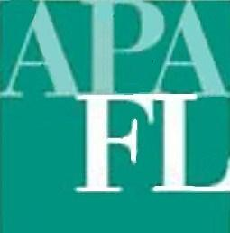



Education/Outreach for Professionals of the “Built Environment”: Urban and Regional Planning Professionals
American Planning Association Florida
ICLEI: Local Governments for Sustainability
Southwest Florida Regional Planning Council
HOK
FSU Department of Urban and Regional Planning
Key “Academic” Strategic Partner: Florida
Center for Environmental Studies - FAU

Slide 18
Climate Change Education for Planning professionals:
Goal: To strengthen and standardize knowledge of CC, mitigation and adaption across the region
Surveys to assess education/information needs and learning format preferences by job profile [Ongoing]
Define geographic or regional needs, toward providing place-based, relevant CC content.
Identify opportunities for information sharing, cooperation, professional development
Develop education plan – universities, continuing education, professional education, and/or certification maintenance activities.

Slide 19
CACCE Activities for/with Planners and Professionals:
Past:
  Tampa Bay Downtown Partnership “Downtown Debrief” on Climate Change and Adaptation: May 15, 2011
  APA FL Annual Conference, Sept 9-11, 2011 (CACCE sponsorship and exhibits)
  Survey review/strategies meeting (associated with APA Executive Committee meeting) 1/19/12, Orlando, FL
Upcoming:
  2nd Annual Coastal Cities Summit, St. Petersburg, FL (CACCE-sponsored sessions on Climate Change Impacts): 5/12
  Risk and Response: Sea Level Rise Summit (Target audience: FL policy professionals. Led by FCES-FAU partners; CACCE co-sponsoring and planning education sessions) 6/21-22/12

Slide 20

2) CACCE Education/Outreach to Informal Science Educators
Events:
  FL CACCE Informal Science Educators workshop on Climate Change, 4/15/11
  Communicating Climate Science to Informal Audiences: a joint CACCE COSEE Florida workshop: 8/11/11
Survey of FL informal science educators (through the FL informal education network) results:
  a) very little being presented on climate change, irrespective of venue (!!);
  b) Need relevant, place-based climate science content/climate scientists to work with!
Upcoming: Second CACCE Informal Educators Workshop, 3/12

Slide 21




2)Education/Outreach to Caribbean Stakeholders
Lead Partners: UPR-M, UVI
Strategic Partner: Inter-American Development Bank
  also working closely with Sea Grant PR, Caribbean Community Climate Change Centre and the Caribbean Tourism Organization
  Targeting the Tourism industry, policy professionals, and formal educators (college and K-12)

Slide 22
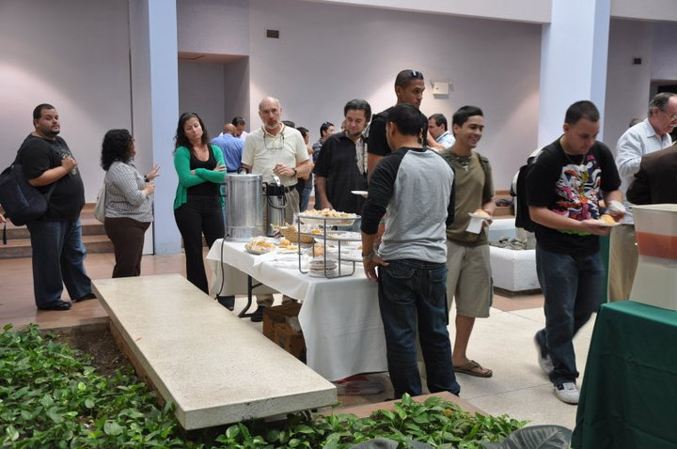
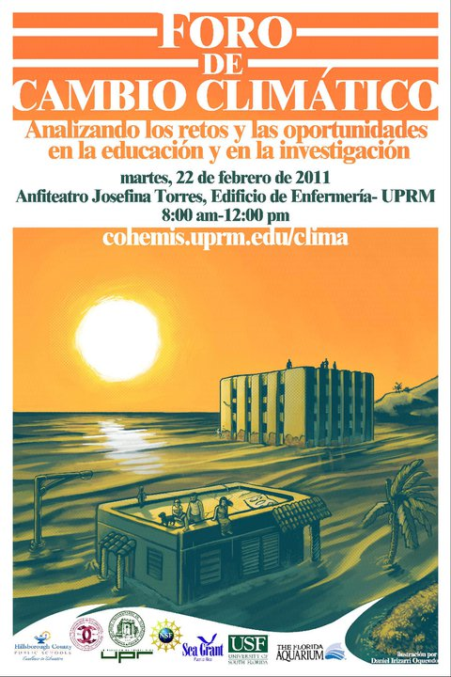
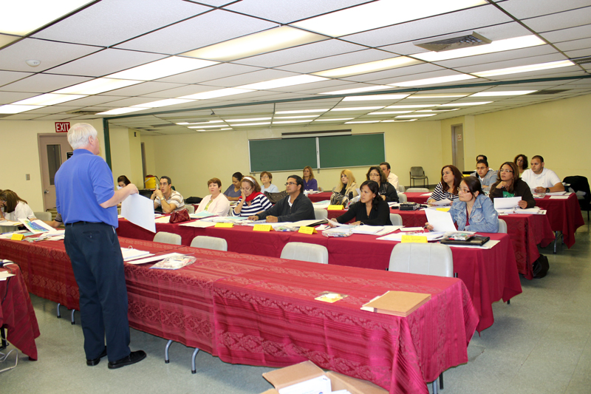
CACCE Activities in PR, VI, and the Caribbean
Past:
  Spanish translation of the interagency Climate Literacy
  document for PR, FL, and Caribbean distribution
  Foro de Cambio Climatico (CoHemis-CACCE
  Short workshops on climate change issues
  and responses): 2/11, 3/11, 9/11
  Invited talks on climate change and adaptation strategies at IADB-sponsored meetings in Guatemala, Trinidad, Guyana, and Sweden
Upcoming:
  CACCE/CoHemis/IADB International Climate Forum 2/1-3/12
  CACCE climate change workshop with VI tourism professionals: 4/12
  CTO Sustainable Tourism Conference, 4/17/12 (CACCE sponsored sessions)

Slide 23
CACCE for Phase 2?

Slide 24
Thanks for your Attention!Questions?

