Slide 1
Climate Change Education Modules
Developed By Members of the:
Council of Environmental Deans & Directors
A Program of the:
National Council for Science and the Environment
Presentation to the
Climate Literacy Network
November 16, 2010

Slide 2
Presentation Agenda
Introduction to the organization and this project: David Blockstein, NCSE
Encyclopedia of Earth and Earth Portal: Andy Jorgensen, U of Toledo & NCSE
Presentation of selected modules:
  Ice Core Data and Recent Climate Change: David Kitchen, U of Richmond
  Climate Change Impacts on Colorado River Water Supply: David Hassenzahl, Chatham U & NCSE, Patricia Mynster, U of Nevada Las Vegas
  Climate Change and Wine: Arnold Bloom, U of California at Davis
Using the project evaluation tools: Tim Weston, U of Colorado, Boulder
Q & A and general discussion: Andy Jorgensen

Slide 3


>National Council for Science & the Environment
>Council of Environmental Deans & Directors
>Climate Change Education Project
Introduction to:
David Blockstein
Director of Education & Senior Scientist, NCSE
Executive Secretary, CEDD
David@NCSEonline.org

Slide 4

NCSE Mission:
to improve the scientific basis of environmental decisionmaking.
NCSE Focus:
programs that bring together diverse institutions, communities and individuals to collaborate
www.NCSEonline.org

Slide 5

Council of Environmental Deans
and Directors
Top Environmental Leaders at Affiliate Universities
Curriculum, including Climate Solutions Curriculum
Careers, including Environmental Alumni Career Study and Campus to Careers Program
Program Administration
Interdisciplinary Hiring, Tenure and Promotion
http://www.ncseonline.org/cedd

Slide 6
NASA-NCSE Interdisciplinary Climate Change Education (NNICCE)
Present Project:
Funded by
NASA Global Climate Change Education

Slide 7
Project Goal
To develop a robust curricular package for a general education course on climate change that universities across the country can readily adopt and adapt.
Course components are based on NASA resources and other sources; they encourage students to study the issues independently and propose solutions based on objective information.

Slide 8
Available NASA Resources
Landsat satellite images
  1975, 1985, 1995, 2005
    Includes indication of vegetation and drought
    27 local settings, 27 regional settings, all US
Precipitation and temperature data
Climate Time Machine

Slide 9
Related Project by NCSE
Creating a Learning Community for
Solutions to Climate Change
Through the NSF’s Climate Change Education program NCSE is creating a nationwide cyber-enabled learning community called:
CAMEL (Climate, Adaptation, and Mitigation e-Learning).
CAMEL will engage experts in science, policy and decision-making, education, and assessment in the production of a virtual toolbox of curricular resources designed for teaching climate change causes, consequences, and solutions.
The audience will be faculty who teach at all undergraduate levels.
NNICCE Resources will become first components of CAMEL

Slide 10
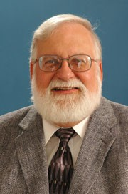
Encyclopedia of Earth and
Earth Portal for
Module Access & Use
Andy Jorgensen
Associate Professor of Chemistry, University of Toledo
Senior Fellow, NCSE
andy.jorgensen@utoledo.edu

Slide 11
Module Access and Use
Encyclopedia of Earth (EoE)
Earth Portal (EP)
Peer-reviewed online encyclopedia
Freely available to the public
Wiki-based
Extensive and Expanding
  1,400 contributors from 60 countries, 64 content partners
  Over 5,000 published articles
Content includes encyclopedia articles, collections, curricula, e-books and more
Connect to content, groups and people
Dynamic, customizable websites
Easily integrates EoE articles into your website
Educators-only portal for the NASA project modules
Open for comments
Developed by TrUnity

Slide 12
TrUnity
TrUnity’s Online Platform
  Gives organizations and individuals the power to organize information and build communities
Anyone can build their own portal with:
  Blogs, Articles
  News and events notices
  Multimedia components
  Networking by connecting to individuals and groups

Slide 13
NNICCE Modules on the
Encyclopedia of Earth
What is available:
  Module resources including content, presentations, and exercises
  Links to other encyclopedia articles for deeper understanding
Who can access:
  Everyone, including your students

Slide 14
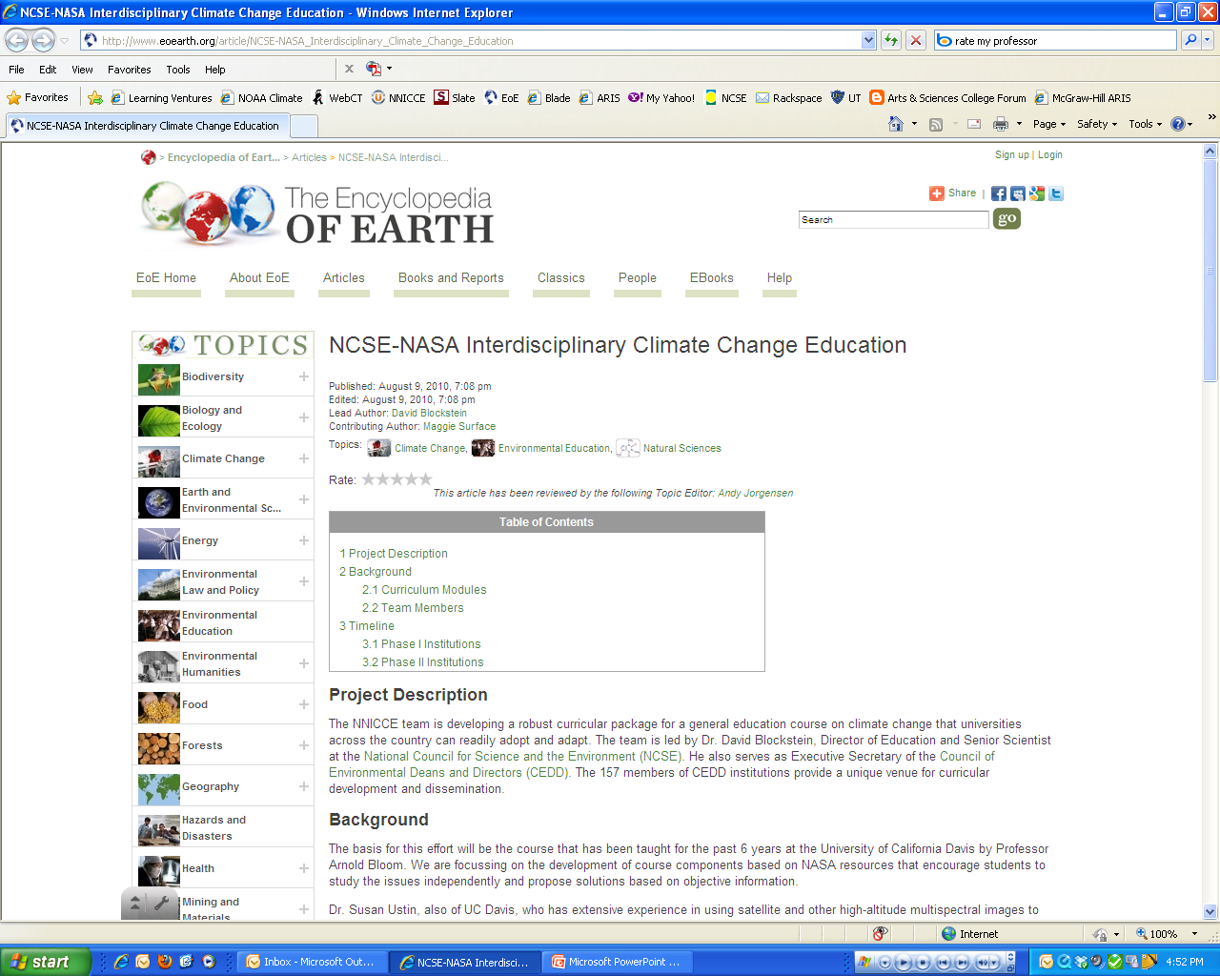
http://www.eoearth.org/article/NCSE-NASA_Curriculum_Module_-_Recent_Climate_Change

Slide 15
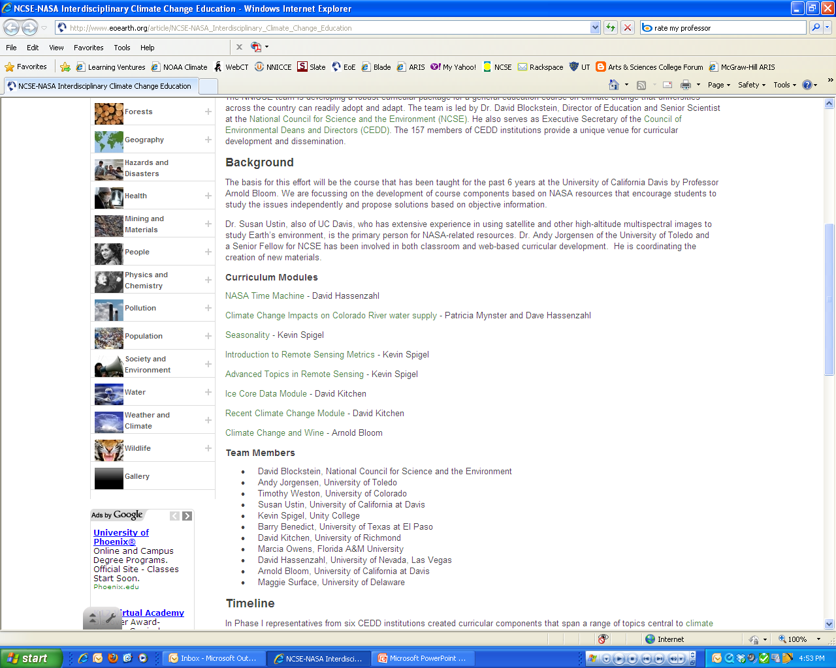

Slide 16
NNICCE Modules on the Earth Portal
What is available:
  Curriculum materials, exercises, powerpoints
  Additional resources, news links, NASA websites
  Advice and tips from module developers (in process)
  Feedback and comments from other teachers
What you can do:
  Create your own website
  Submit comments on the modules
  It will not be accessible to students

Slide 17
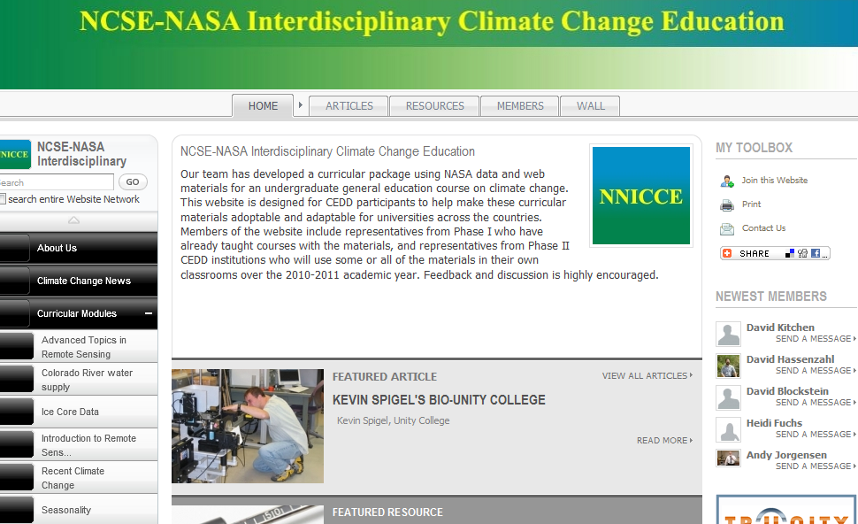
NNICCE Module on the Earth Portal

Slide 18
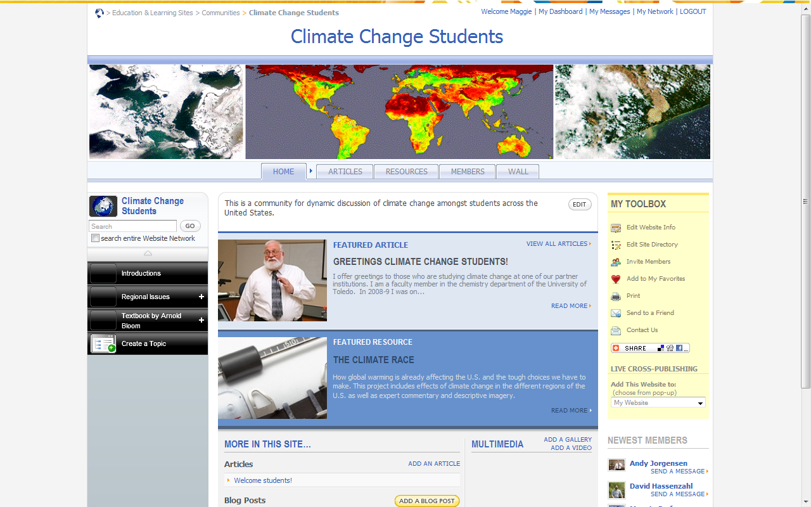
Student Community on the Earth Portal

Slide 19
Student Community on the Earth Portal
Students from across the country can access this portal to discuss the modules
Provides an additional way for students to relate to the material by connecting with students from other areas
Highlights the global aspect of climate change
You can create a student subportal exclusively for your students.

Slide 20
Introduction to Specific Modules

Slide 21

Ice Core Data and
Recent Climate Change
David Kitchen
Associate Dean, Associate Professor
University of Richmond

Slide 22
Modules
THIS IS NOT HARD STUFF! ☺
Prehistoric and Historic Data
Set modern climate change in an historical context
Invite students to interact with real data

Slide 23
Topics
Ocean Core Data
  Sea Level
  Temperature
Ice Core Data
  Temperature
  Greenhouse Gases
  Dust
Historical Data
  Land & Ocean Surface Temperature (measured and proxy)
  Solar Data (measured and proxy)
  Astronomical Data
  Greenhouse Gas Data (measured)
  Natural cycles in the oceans and atmosphere

Slide 24
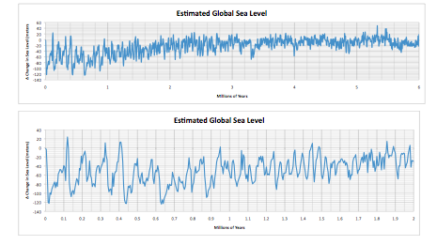
The Data Record

Slide 25
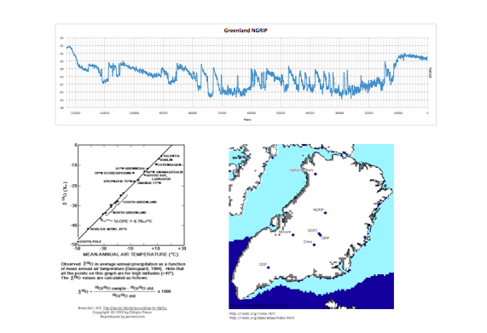
The Data Record

Slide 26
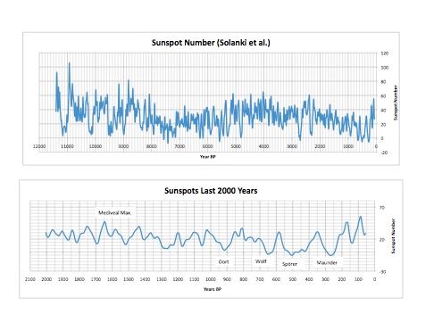
The Data Record

Slide 27
Pedagogy
Pedagogy
  Aim/Introduction
  Learning Outcomes
  Exercises and sample answers
  Added Value
Supporting Resources
  Arnold Bloom Book
  David Kitchen Book (on request)

Slide 28
How to use the modules
Can be used to support a section on ancient climate
Students introduced to real data
Use to discuss many issues:
  Data sources/interpretation/reliability
  Rates of temperature change
  Role of the sun
  Role of greenhouse gases
  Ocean/Atmospheric Circulation

Slide 29
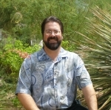
Climate Change Impacts on Colorado River Water Supply
David Hassenzahl
Dean and Professor of Sustainability and the Environment
Chatham University
Patricia Mynster
University of Nevada, Las Vegas

Slide 30
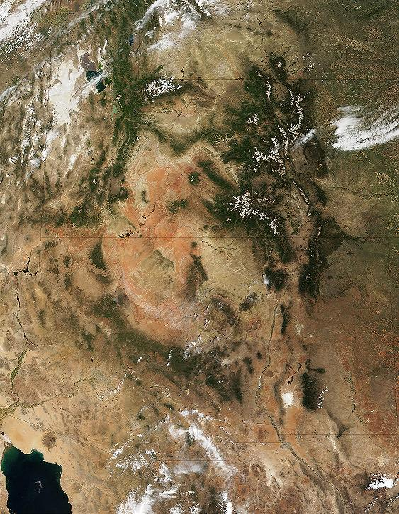

Slide 31
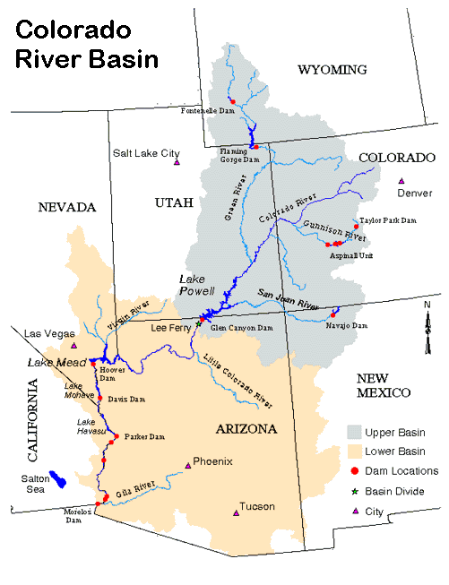
Allocation | Million Acre Feet Per Year (MAFY)
Upper Basin | 7.5
Colorado | 3.9
Utah | 1.7
Wyoming | 1.0
New Mexico | 0.85
Lower Basin | 7.5
Arizona | 2.85
California | 4.4
Nevada | 0.3
Additional Allocations
Mexico | 1.5
Total | 16.6

Slide 32
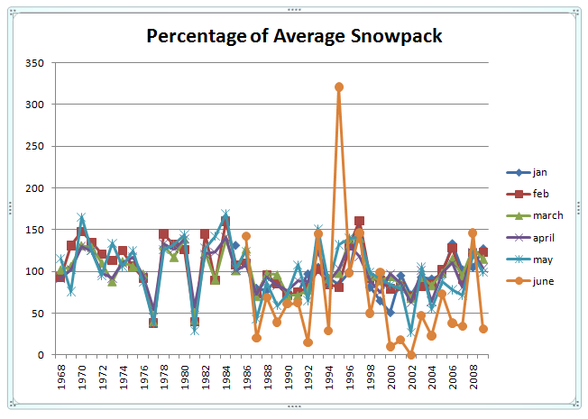
Notes:
Print out the questions on one side of the data tables for them to work on in groups.

Slide 33
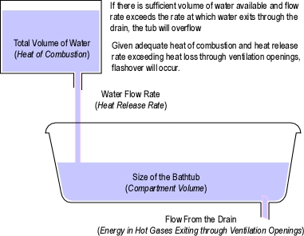
Water from Colorado Snowpack
Water from the Upper Basin is released into the Lower Basin and stored at Lake Mead.
Lake Mead
Water levels depend on the rate of water coming in compared with the rate of water being released
Hoover Dam acts as the drain plug in the tub allowing the reservoir to fill up. Water is released to California and Arizona for their water use and production of hydro-electric power.

Slide 34
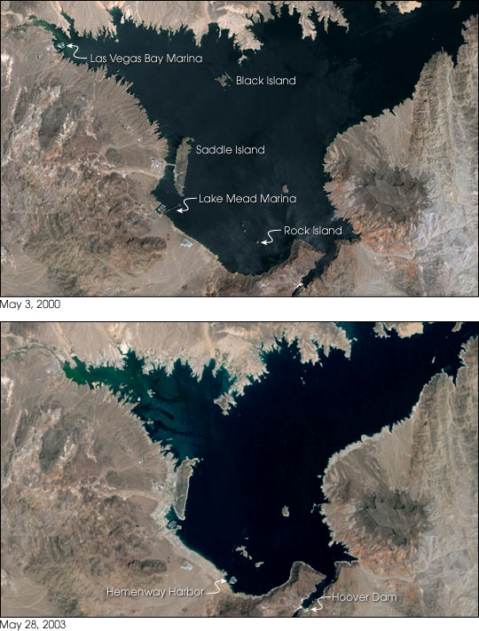

Slide 35
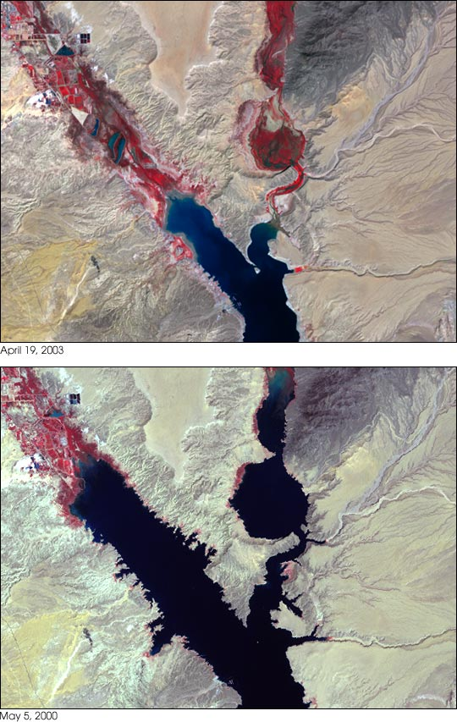

Slide 36
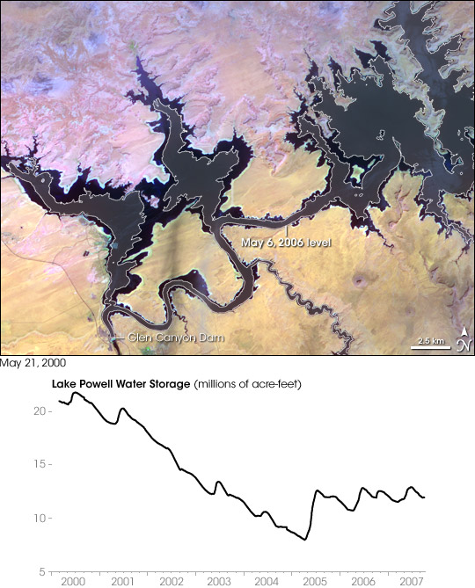

Slide 37
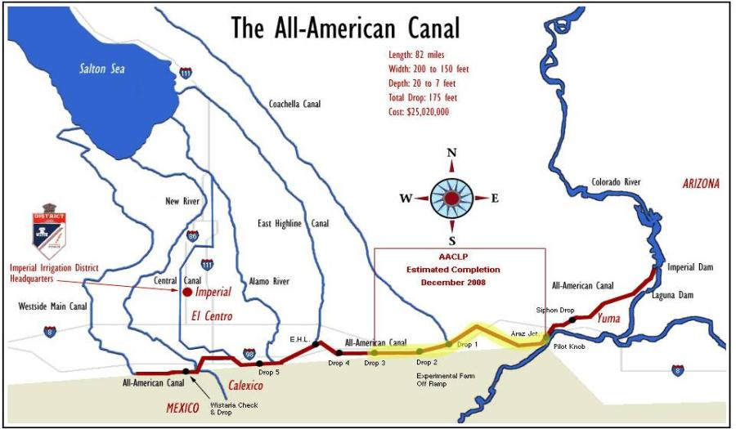
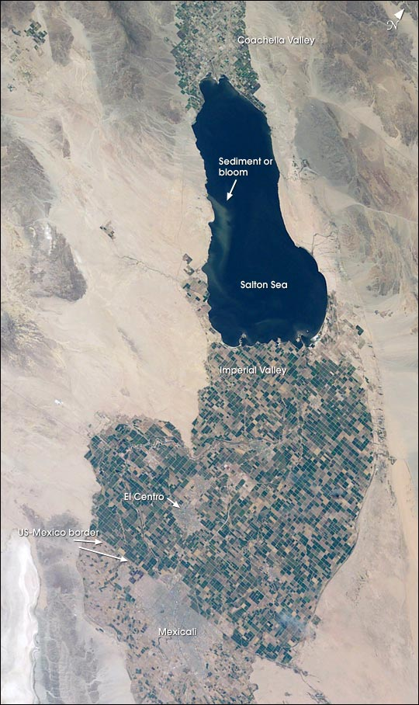
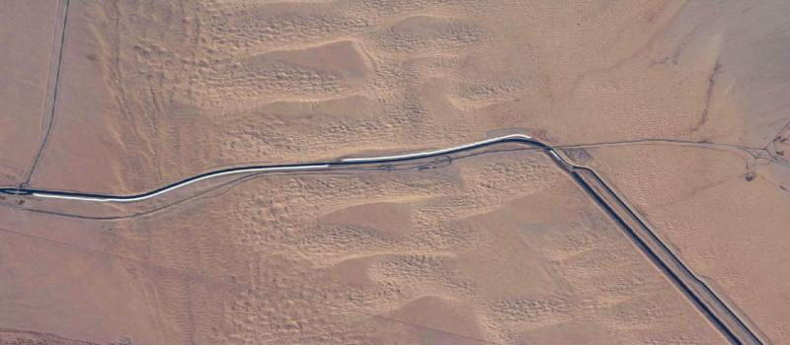

Slide 38
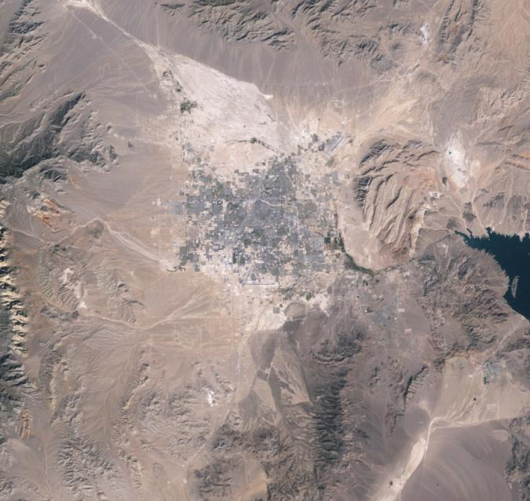
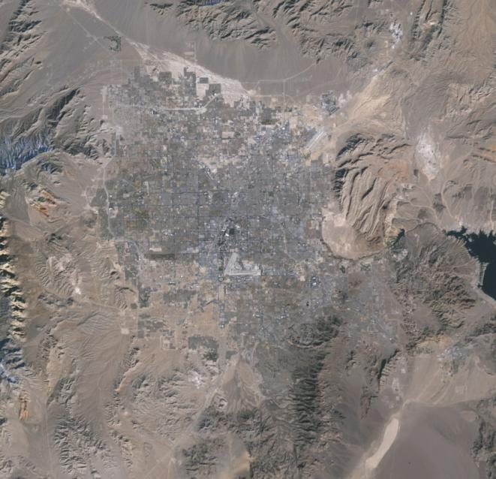
Las Vegas Valley
1984
2009

Slide 39
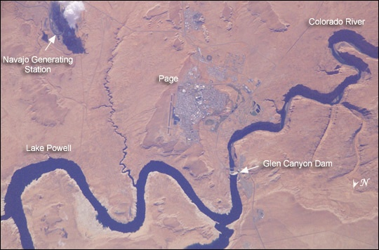

Slide 40
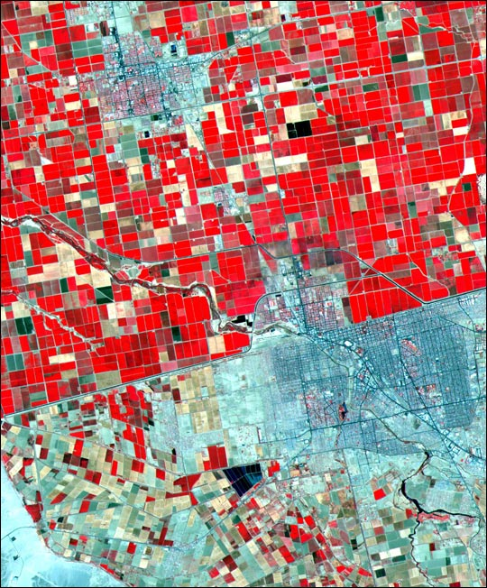

Slide 41
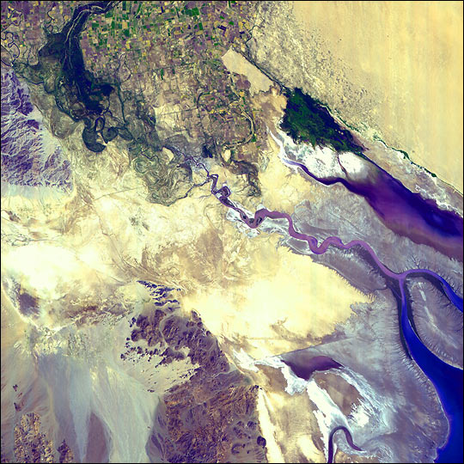

Slide 42

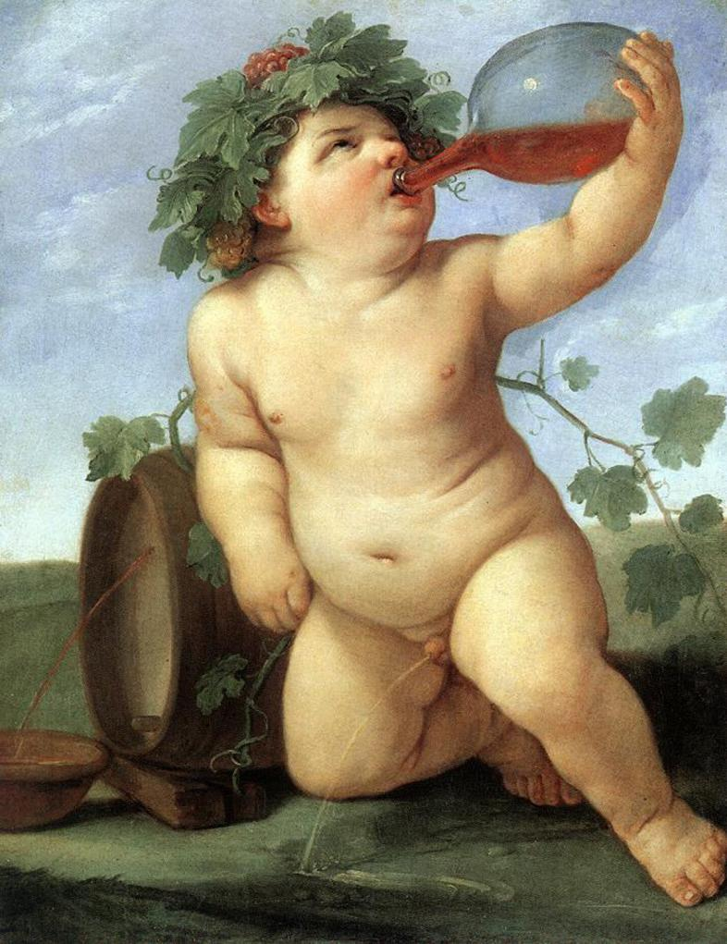
Arnold J. Bloom
Dept. of Plant Sciences
U. of California at Davis ajbloom@ucdavis.edu
Using Satellite & Ground Data to Examine Climate Change & Premium Wine Production in California
Drinking Bacchus Reni, Guido c.1623

Slide 43
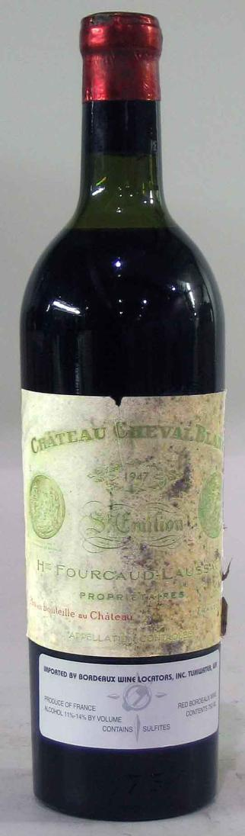
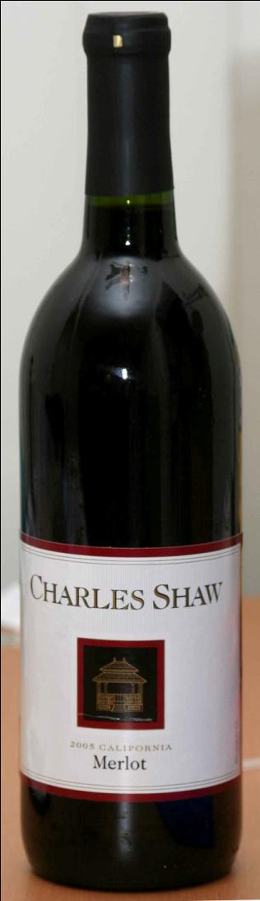
1947 Chateau Cheval Blanc Vinfolio
San Francisco, July 2006
$33,781.25
2005 Charles Shaw Merlot
“Two-buck Chuck”
Trader Joe’s
$1.99

Slide 44
“Premium wine grapes are produced almost exclusively in a narrow climatic range characterized by a lack of both extreme heat and extreme cold.”
Napa Valley Petit Verdot grapes = $5,409 per ton
San Joaquin Valley red grapes = $270 per ton
20-fold difference in price

Slide 45
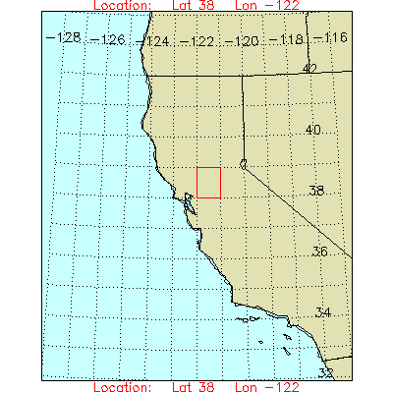
Ft. Bragg
Colfax
Napa
Davis

Slide 46
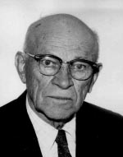
Winkler Scale
Technique for classifying the climate of wine growing regions.
Developed at UC Davis by A. J. Winkler and M. Amerine 1944.
Sum of degree days over 10°C from April 1 until October 31.
= Σmax [(avg. daily temp. – 10), 0]

Slide 47
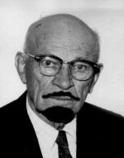
Winkler Scale
Regions I (1,111 – 1,390 growing-degree days) and II (1,391 – 1,670 growing-degree days) generally produce the best dry table wines with light to medium body and good balance.
Region III (1,671 – 1,950 growing-degree days) produces full-bodied dry and sweet wines.
Region IV (1,951 – 2,220 growing-degree days) is best for fortified wines, with table wines being inferior.
Region V (2,220 – 2,499 growing-degree days) is best for table grapes and makes low-quality table wines.

Slide 50
Ft. Bragg
0
Colfax
III
Napa
III
Davis
V

Slide 51
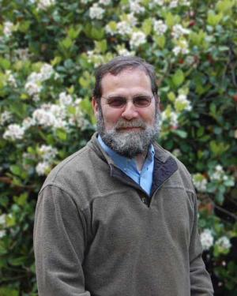


Slide 52
Conclusions
Satellite data
  Spatial resolution too low
  Time scale too short
  White et al. (2008) http://digitalcommons.unl.edu/cgi/viewcontent.cgi?article=1025&context=nasapub
Ground data
  Year-to-year variation obscures trends
  Running averages show trends
  Climate change is shifting premium grape growing areas

Slide 53

Using the Project Evaluation Tools
Tim Weston
University of Colorado at Boulder

Slide 54
Purposes for Assessment
Do students’ attitudes toward climate change shift from pre to post?
Do students understand specific global warming topics after completing modules?

Slide 55
Assessment Instruments:
Attitude Questions for pre/post
Fourteen agree/disagree attitude questions:
  “I believe people should change their lifestyles to help minimize climate change.”
Five self assessment questions
  How informed are you about the different causes of climate change? (Very well informed, Informed, Not at all informed)
Two previous experience questions
  Previous science courses, Actions related to climate change (taken courses, discussed climate change, changed personal behaviors.

Slide 56
Ten content knowledge questions
Over the last century, global average temperatures have:
  cooled about 0.1°C (0.2°F).
  not changed significantly.
  warmed about 0.1°C (0.2°F).
  warmed about 0.6°C (1°F).
  warmed about 6.0°C (10°F).
Questions used for pre-assessment; compared with specific questions on the post.

Slide 57
Specific questions keyed to modules
Standard content questions keyed to module content such as Climate Change and Wine Grape Quality.
Pre-post comparisons allow descriptions of understanding by classes adjusted for differences in pre test. These tests are similar to regular classroom assessments but are online.

Slide 58
Accessing assessments
Assessments accessed online through Surveymonkey. Each institution has own versions of the assessments. Results are sent to faculty after administration.
Example: https://www.surveymonkey.com/s/JTWQNX7

Slide 59
Human Subjects
Student responses are anonymous and are used in aggregate so students do not need to fill out informed consent.
Most institutions will honor approval that has been granted from the University of Toledo; we will send letter to each participating institution.
Assessment used for classroom purposes does not need approval.

Slide 60
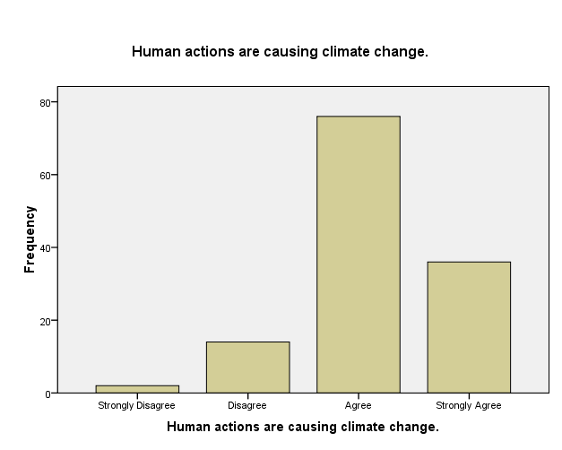
An Example of Results from Toledo n = 128
Large majority of students agree with statements such as: “I believe people should change their lifestyles to help minimize climate change.” (~90%)

Slide 61
Links to attitude and content questions
  Attitude
    https://www.surveymonkey.com/s/JBDKWXS
Content
  https://www.surveymonkey.com/s/JTWQNX7
  Contact Tim Weston for your own link:
  westont@colorado.edu

Slide 62
Additional Partners
Kevin Spigel, Unity C
Marcia Owens, Florida A & MU
Barry Benedict, U of Texas El Paso
Maggie Surface, U of Delaware
Susan Ustin, U California at Davis

Slide 63
For further information and assistance:
Andy Jorgensen
andy.jorgensen@utoledo.edu
419-530-4579

