Slide 1
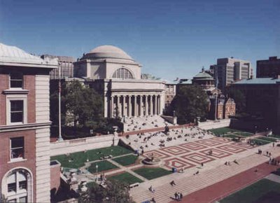
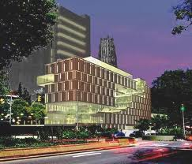
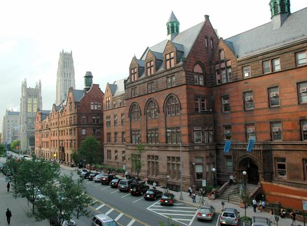
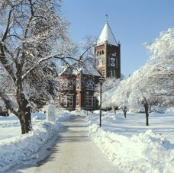
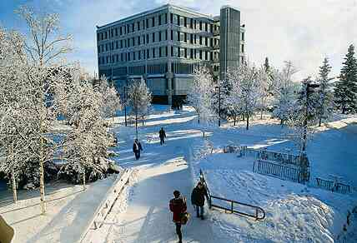
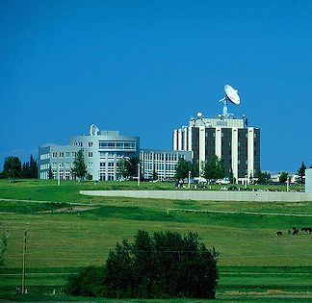
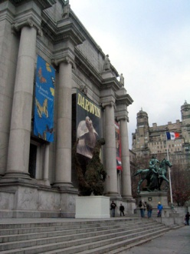
POlar Learning And Responding:
POLAR Climate Partnership
Partners: Columbia Climate Center at the Earth Institute, Columbia University Center for Research on Environmental Decisions; Barnard College; Teachers College; University of New Hampshire; University of Alaska-Fairbanks;
American Museum of Natural History;
International Arctic Research Center
Supported by NSF under CCEP Phase I
The vision of the NSF-supported POLAR Climate Change Education Partnership is to use fascination with the changing polar regions and novel educational approaches to engage adult learners and inform public discussion and response to climate change.

Slide 2
Our Partnership
Climate researchers
  Columbia’s Lamont-Doherty Earth Observatory (LDEO) and Columbia Climate Center (CCC), Barnard College
  University of New Hampshire (UNH)
  University of Alaska, Fairbanks (UAF)
  International Arctic Research Center (IARC)
Learning and decision experts
  Teachers College (TC)
  Columbia Center for Research on Environmental Decisions (CRED)
  IARC
Formal education practitioners
  Columbia Center for New Media Teaching and Learning (CCNMTL), Barnard College UNH, & UAF
Informal education practitioners
  American Museum of Natural History (AMNH) and IARC

Slide 3
Focus on the Poles
The poles are ground zero for
climate change: the fastest
changes occur in the Arctic
and the Antarctic Peninsula
These changes extend globally: sea level rise, change in albedo, and release of greenhouse gases from thawing permafrost
The public
  identifies global warming with sea ice, glaciers, and ice sheets, polar fauna
  Is fascinated with and concerned about life in extreme polar environments

Slide 4
Focus on Adult Learners
College students, pre- and in-service teachers, and life-long learners in the general public
  Populations include future scientists, educators and citizens, to managers, youth in remote communities, and the general public
They need to make decisions in their personal, professional and community lives, and yet many are confused about what is known and how to respond
We are engaging stakeholders representing NGOs, business, community leaders, resource managers, and other decision-makers to identify and meet their needs

Slide 5
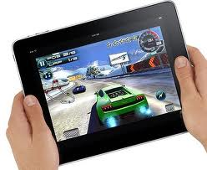
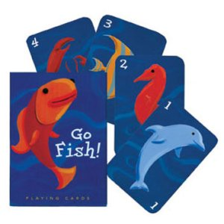

Focus on Game-like Approaches, Interactive
Animations, Visualizations, and Social Networks
Simulations, games, social networks, interactive data interfaces, reduced-complexity models, hands-on demonstrations reach different people in different ways.
  Allow for independent discovery rather than one-way communication Interactive
  They reach different people in different ways
  Motivate people to pay attention
  Help people sort through, evaluate and make decisions regarding complex material
  Many are easily disseminated and used in diverse formal and informal settings

Slide 6
Inventory
Adult focused polar/climate activities, resources, data sets and model interactive approaches
  1) The vast majority are focused towards professional development for high school teachers
  2) There are significantly more Arctic than Antarctic resources available
  3) The top 3 topics addressed in the inventory we have found are (in order) sea ice, marine ecosystems, glaciers
  4) A variety of materials exist but a large amount represent satellite visualizations & short film clips/annotated films of either a scientists speaking about their work or a native individual speaking about local change – many created during IPY
  For the general adult audience (non academic focus) the resources tend to fall into two distinct categories –
    Animations and visualizations i.e. NASA's 'Tour of the Cryosphere', or
    Institution or websites with collected information i.e. Woods Hole's 'Polar Discovery' site
  Items that are not well represented in the inventory are
    Polar games
    Engaging simulations involving interaction or manipulation
    Problem solving collaborative pieces

Slide 7
CRED: The Psychology of Climate Change Communication
Know Your Audience
Get Your Audience’s Attention
Translate Scientific Data into Concrete Experience
Beware the Overuse of Emotional Appeals
Address Scientific and Climate Uncertainties
Tap Into Social Identities and Affiliations
Encourage Group Participation
Make Behavior Change Easier

Slide 8
Stakeholder Input
Making issues local and/or personal makes them more meaningful
Embedding responses to climate change into the context of sustainable development which firmly places climate change into the larger framework of jobs, health, legacy, etc. makes them more likely to gain traction with both individuals and organizations
Stories are invaluable to communicate the complex, interconnected, and intergenerational aspects of climate change
Person to person communication is important, even if the guide is an avatar
Polar trends, predictions, and polar-global relationships need a systems framework for contextualization
Focus on adults
Trade-offs
How personal/community actions make a difference
Concept and consequences of being “reactive” vs. “proactive”
Engaging communities as problem-solvers
Variety of approaches/media

Slide 9
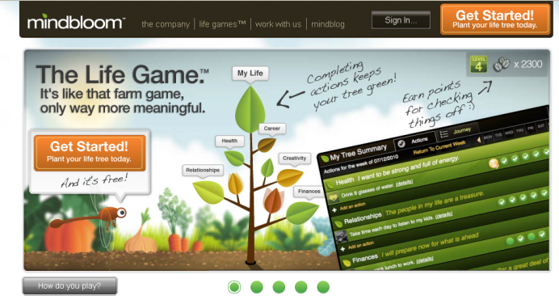
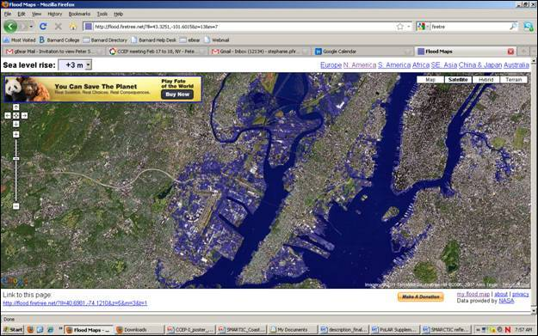
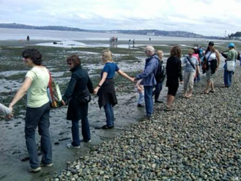
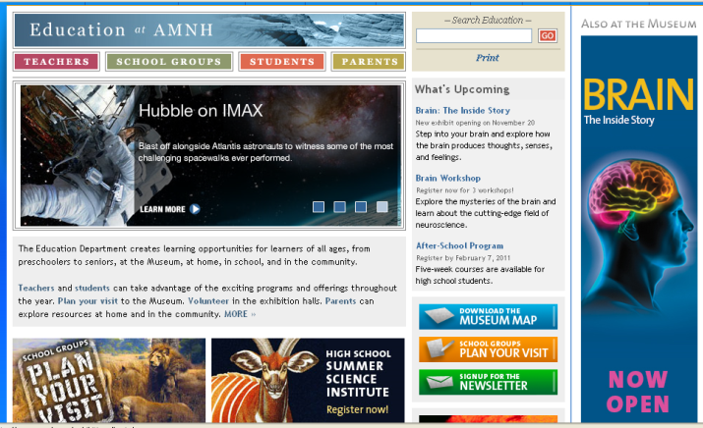
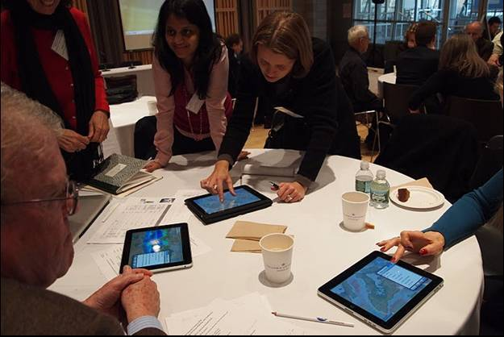
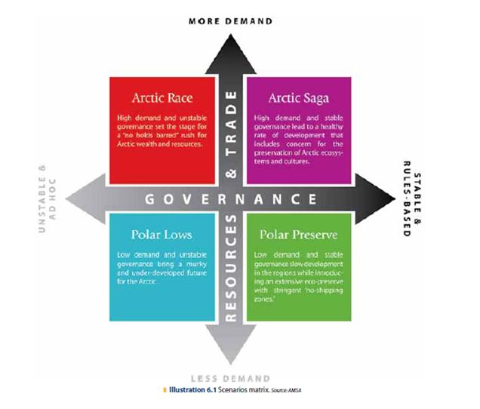
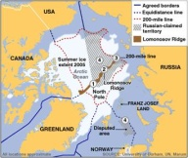
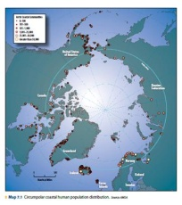
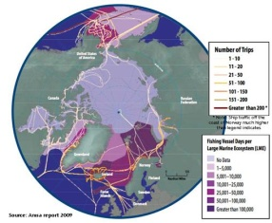
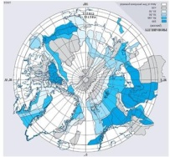
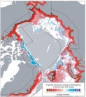
Future Coast
Where will the shoreline be in 2100?
How would that change your community?
What is the process of change going to be? How will the process of adaptation play out? What is actually going to happen to the coastal properties of today?
Gamification
Facilitates setting priorities and tracking behavioral change
AMNH Teacher Testbeds
iPad Polar Explorer
Interactive news platforms connecting to personally navigated tours of the cryosphere
Arctic SMARTIC
Strategic MAnagement of Resources in TImes of Changing Climate
Players assume roles to engage in problem solving using real data
Country Claims
Coastal Communities
Ship Traffic and Fishing Intensity
Oil and Gas Potential
Polar Bear Habitat 2050

Slide 10
From Awareness to Decisions
Polar Explorer
Greenify
Future Coast
SMARTIC
AMNH Online Teacher Ed
Arctic Home
Awareness
Decisions

Slide 11
From the Classroom to the General Public
AMNH Online Teacher Ed
Greenify
FUTURE COAST
Arctic Home
Polar Explorer
SMARTIC
Classroom
Public

Slide 12
From Low-Tech to High-Tech
Arctic Home
Greenify
AMNH Online Teacher Ed
Polar Explorer
SMARTIC
FUTURE COAST
Low-tech
High-tech

Slide 13
“Arctic Home” Card Game
Learning
  “Sense of how some species have variety of what to eat/fragility of system”
  “How the food chain works, how vulnerable it is”
Emotions
  “At first excited to create and then sadness over loss”
  “Sad, animals die, and then ecosystems die; competitive, excited”
  “Sad for the ecosystem – urgency”
  “Engagement; it was cool”

Slide 14
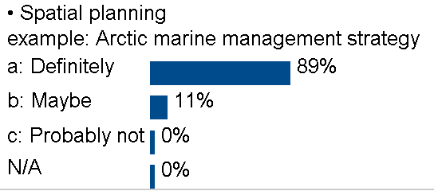
SMARTIC –
Engaging in complexity
“Responding to Climate Change” students
  “This was a great, interactive way to gain exposure to different factors influencing the debate about the ever more desirable land and water in the Arctic. The most valuable thing that came out of this exercise was precisely the exposure and awareness of all of the different factors.”
  “The variety of stakeholders that exist makes coming up with viable solutions difficult. There are environmental and economic issues to consider in the short run and long run, as well as issues of international relations.”
  “Combining shipping route information and mineral abundance with high fish biodiversity and mammal hotspots, as well as the locations of the highest concentration of people, helps people to visualize where action and management practices need to occur first in order to impact the highest number of stakeholders. ”
  “… before this activity, I had thought of the stakeholders, but I thought they were all in conflict with each other; it turns out that only certain ones are in conflict with each other in certain areas. “

Slide 15
Overall RCC Course Evaluation

Slide 16
Engaging Stakeholders = Dissemination Partners and Audiences, for Ideas and Impact
Audiences
Dissemination Partners
Developmental Partners
PoLAR Team

Slide 17
PoLAR: Using fascination with the changing polar regions and novel educational approaches to engage adult learners and inform public discussion and response to climate change
By using interactive activities and games:
  We engage adult learners to deepen awareness and understanding of and inform responses to climate change, elevating it to a personal and community challenge.
  Using the polar regions as a focal point, the partnership builds upon scientific evidence, learning theory, and education practice, including current and emerging technology, to catalyze new ways of learning about climate change.
  The resulting approaches are transformative, easy to disseminate, and exciting to use by stakeholders in homes, museums, classrooms, and communities.

Slide 18
Your ideas …
Experience using games and game-like approaches/problem solving? Positives, negatives?
CLN and other contacts/venues for dissemination? Businesses, managers, etc.?

