Slide 1
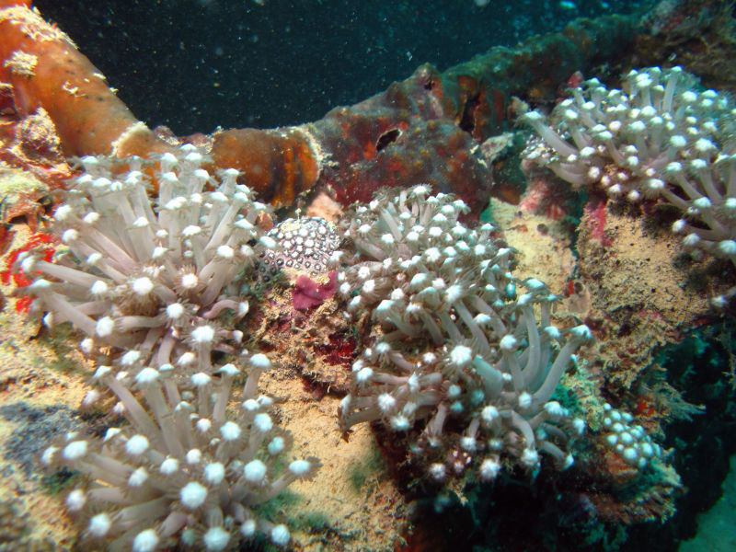
The Pacific Islands Climate Education Partnership (PCEP)
A 2-year Phase 1 project funded by the National Science Foundation (NSF)
Photo by Susan Burger

Slide 2
PCEP is a collaboration between
PREL and WestEd
Co-Principle Investigators:
Dr. Sharon Nelson-Barber and Dr. Art Sussman
  The PCEP serves the U.S. Affiliated Pacific Islands (USAPI). The PCEP vision is to educate the region’s students and citizens in ways that exemplify modern science and indigenous environmental knowledge, address the urgency of climate change impacts, and honor indigenous cultures.

Slide 3
Key Features
Develop a regional K-14 climate education framework and plan its implementation: what gets taught, when, how, where, for/by whom
Focus on climate change impacts on region’s islands and communities
Involve local communities with a focus on indigenous knowledge
Collaborate with other CCE Partnerships

Slide 4
Key Outcomes
A plan for the culturally responsive adoption and implementation of a multidisciplinary K-14 climate education framework across the USAPI
A collection of curriculum resources and instructional strategies for the Pacific region’s climates and cultures
A web-based information platform that enables development and implementation of the region’s climate education plan
Notes:
A generally accepted K-14 climate science education framework that builds a deep understanding of climate change
Grade-span progressions that will guide climate education and is strongly based on context and the latest research in learning science and climate change understandings – from both science and indigenous experiential knowledge

Slide 5
Core Partners
Climate scientists – Drs. Julian Sachs, Art Sussman, Phil Duffy
Learning scientists – Drs. Bruce Sherin, Megan Bang, Sharon Nelson-Barber, Ursula Sexton
Practitioners (K-12) – the Pacific Curriculum and Instruction Council (PCIC members) coordinated by Drs. Hilda Heine and Marylin Low

Slide 6
Examples of Supporting Partners
Local community organizations
  Commission on Education in Micronesia
  Women United Together in the Marshall Islands
  Micronesian Challenge
  Pacific Island Health Officers Association
  Conservation Society of Palau
Local community colleges
  Guam Community College
  American Samoa Community College

Slide 7
Advisory Board
Dr. Phil Duffy, Principal Research Scientist and Data Lead, Climate Central
Dr. Richard A. Duschl, Chair Secondary Education, Penn State College of Education
Dr. Shirley Brice Heath, Professor of English and Dramatic Literature, Stanford University
Dr. Doug Herman, Senior Geographer, National Museum of the American Indian
Dr. Igor Krupnik, Arctic Studies Center, Smithsonian National Museum of Natural History
Ms. Marie Maddison, Director, National Training Councils, Republic of the Marshall Islands
Dr. Douglas Medin, Professor of Cognitive Psychology, Northwestern University
Dr. Elizabeth Rechebei, Commission on Education in Micronesia, Commonwealth of Northern Mariana Islands
Dr. Don Rubinstein, Professor of Anthropology, University of Guam

Slide 8
Highlights for CLN 5/17/11
FIRST DRAFT of partnership web environment will be introduced and shared
  Links regional locations, organizations, people
  Interlinks the above with climate science content, climate impacts content, learning science content, and regional communities/cultures
  Designed to support collaborative development of regional strategic education plan
  Current status, accomplishments, challenges, plans
  Next steps to populate, make more user friendly, relate Indigenous and Western ways of knowing and being
Organization of climate science content and climate impact content will be introduced/shared

